Slide 1
Matrix sparsification (for rank and determinant computations)
Raphael Yuster University of Haifa

Slide 2
Elimination, rank and determinants
Computing ranks and determinants of matrices are fundamental algebraic problems with numerous applications.
Both of these problems can be solved as by-products of Gaussian elimination (G.E.).
[Hopcroft and Bunch -1974]: G.E. of a matrix requires asymptotically the same number of operations as matrix multiplication.
The algebraic complexity of rank and determinant computation is O(n^{ω}) where ω < 2.38 [Coppersmith and Winograd -1990].

Slide 3
Elimination, rank and determinants
Can we do better if the matrix is sparse having m << n² non-zero entries?
[Yannakakis -1981]: G.E. is not likely to help.
If we allow randomness there are faster methods for computing the rank of sparse matrices .
[Wiedemann -1986] An O(n²+nm) Monte Carlo algorithm for a matrix over an arbitrary field.
[Eberly et al - 2007] An O(n^{3-1/(ω-1)}) < O(n^{2.28}) Las Vegas algorithm when m=θ(n).

Slide 4
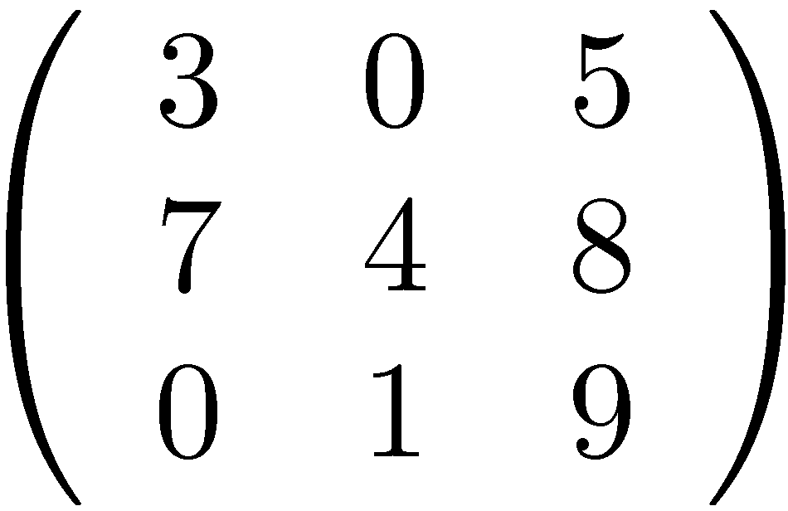
Structured matrices
In some important cases that arise in various applications, the matrix possesses structural properties in addition to being sparse.
Let A be an n × n matrix. The representing graph denoted G_{A}, has vertices {1,…,n} where: for i ≠ j we have an edge ij iff a_{i,j} ≠ 0 or a_{j,i} ≠ 0.
G_{A} is always an undirected simple graph.

Slide 5
Nested dissection
[Lipton, Rose, and Tarjan – 1979] Their seminal nested dissection method asserts that if A is - real symmetric positive definite and - G_{A} is represented by a β-separator tree then G.E. on A can be performed in O(n^{ωβ}) time.
For β < 1 better than general G.E.
Planar graphs and bounded genus graphs: β = ½ [the separator tree constructed in O(n log n) time].
For graphs with an excluded fixed minor: β = ½ [☹ the separator tree can only be constructed in O(n^{1.5}) time].

Slide 6
Nested dissection - limitations
Matrix needs to be:
Symmetric
Real
positive (semi) definite
The method does not apply to matrices over finite fields (not even GF(2)) nor to real non-symmetric matrices nor to symmetric non positive-semidefinite matrices. In other words: it is not general.
Our main result: we can overcome all of these limitations if we wish to compute ranks or absolute determinants. Thus making nested dissection a general method for these tasks.

Slide 7
Matrix sparsification
Important tool used in the main result:
Sparsification lemma
Let A be a square matrix of order n with m nonzero entries. Another square matrix B of order n+2t with t = O(m) is constructed in O(m) time so that:
det(B) = det(A) ,
rank(B)=rank(A)+2t ,
Each row and column of B have at most three non-zero entries.

Slide 8
Why is sparsification useful?
Usefulness of sparsification stems from the fact that
Constant powers of B are also sparse.
BDB^{T} (where D is a diagonal matrix) is sparse.
This is not true for the original matrix A.
Over the reals we know that rank(BB^{T}) = rank(B) = rank(A)+2t and also that det(BB^{T}) = det(A)².
Since BB^{T} is symmetric, and positive semidefinite (over the reals), then the nested dissection method may apply if we can also guarantee that G_{BB}T has a good separator tree (guaranteeing this, in general, is not an easy task).

Slide 9
Main result – for ranks
Let A ∈ F ^{n × n}.
If G_{A} has bounded genus then rank(A) can be computed in O(n^{ω/2}) < O(n^{1.19}) time.
If G_{A} excludes a fixed minor then rank(A) can be computed in O(n^{3ω/(3+ ω)}) < O(n^{1.326}) time.
The algorithm is deterministic if F= R and randomized if F is a finite field.
Similar result obtained for absolute determinants of real matrices.

Slide 10
Sparsification algorithm
Assume that A is represented in a sparse form: Row lists R_{i} contain elements of the form (j , a_{i,j}).
By using symbol 0* we can assume a_{i,j} ≠ 0 ⇔ a_{j,i} ≠ 0.
At step t of the algorithm, the current matrix is denoted by B_{t} and its order is n+2t. Initially B₀=A.
A single step constructs B_{t +1} from B_{t} by increasing the number of rows and columns of B_{t} by 2 and by modifying constantly many entries of B_{t}.
The algorithm halts when each row list of B_{t} has at most three entries.

Slide 11
Sparsification algorithm – cont.
Thus, in the final matrix B_{t} we have that each row and column has at most 3 non-zero entries.
We make sure that: det(B_{t+1}) = det(B_{t}) and rank(B_{t+1}) = rank(B_{t})+2.
Hence, in the end we will also have det(B_{t}) = det(A) and rank(B_{t}) = rank(A)+2t.
How to do it: As long as there is a row with at least 4 nonzero entries, pick such row i and suppose b_{i,v} ≠ 0 b_{i,u} ≠ 0 .

Slide 12
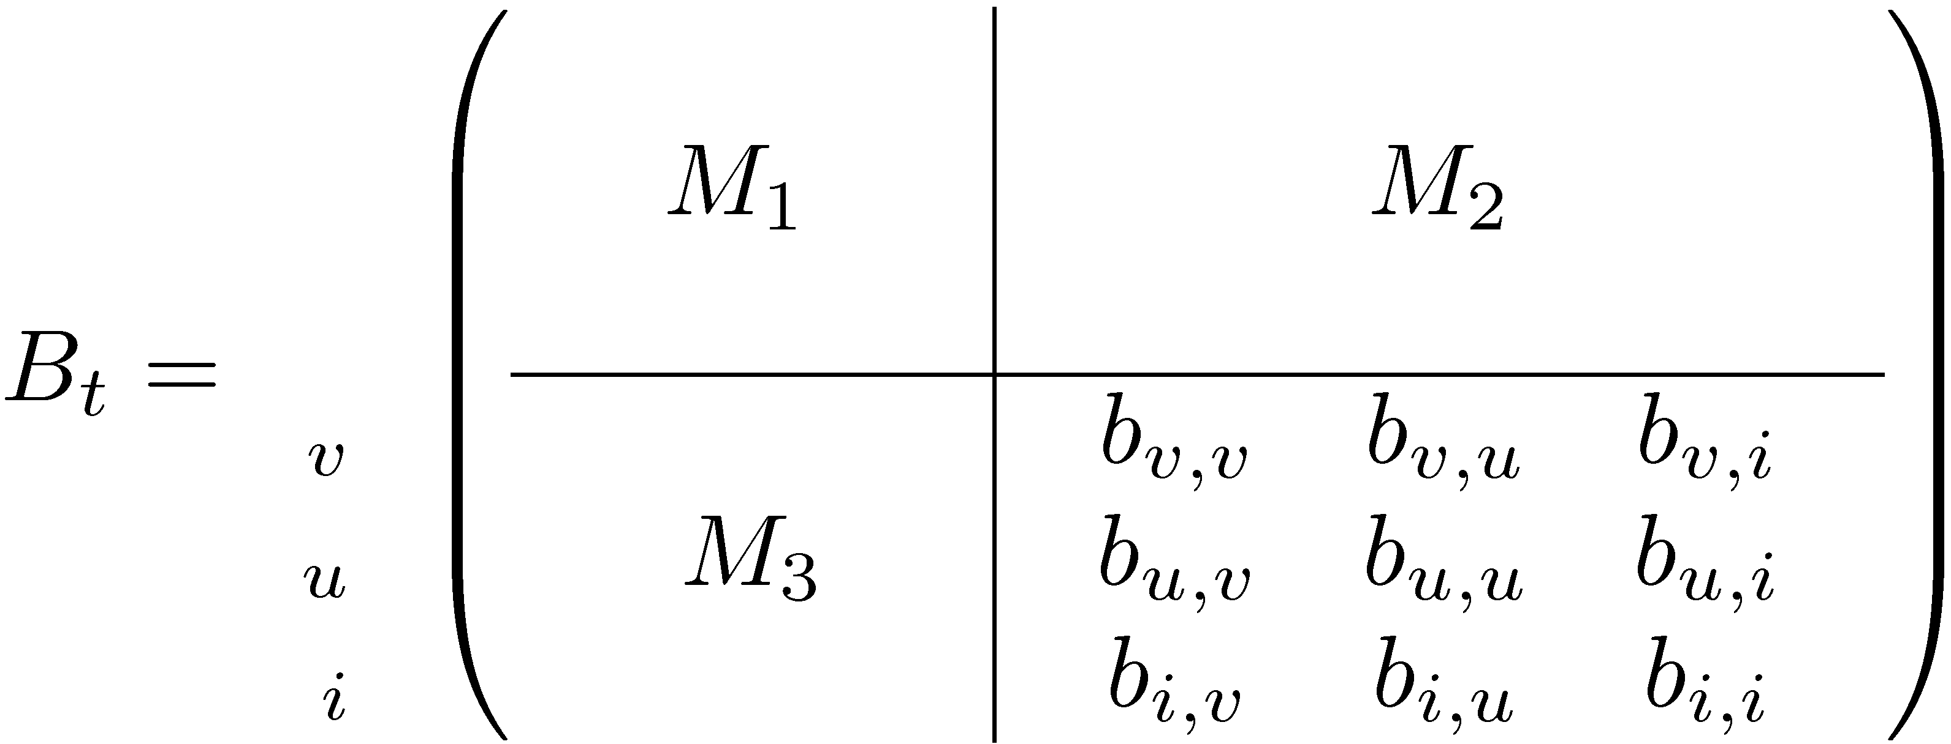
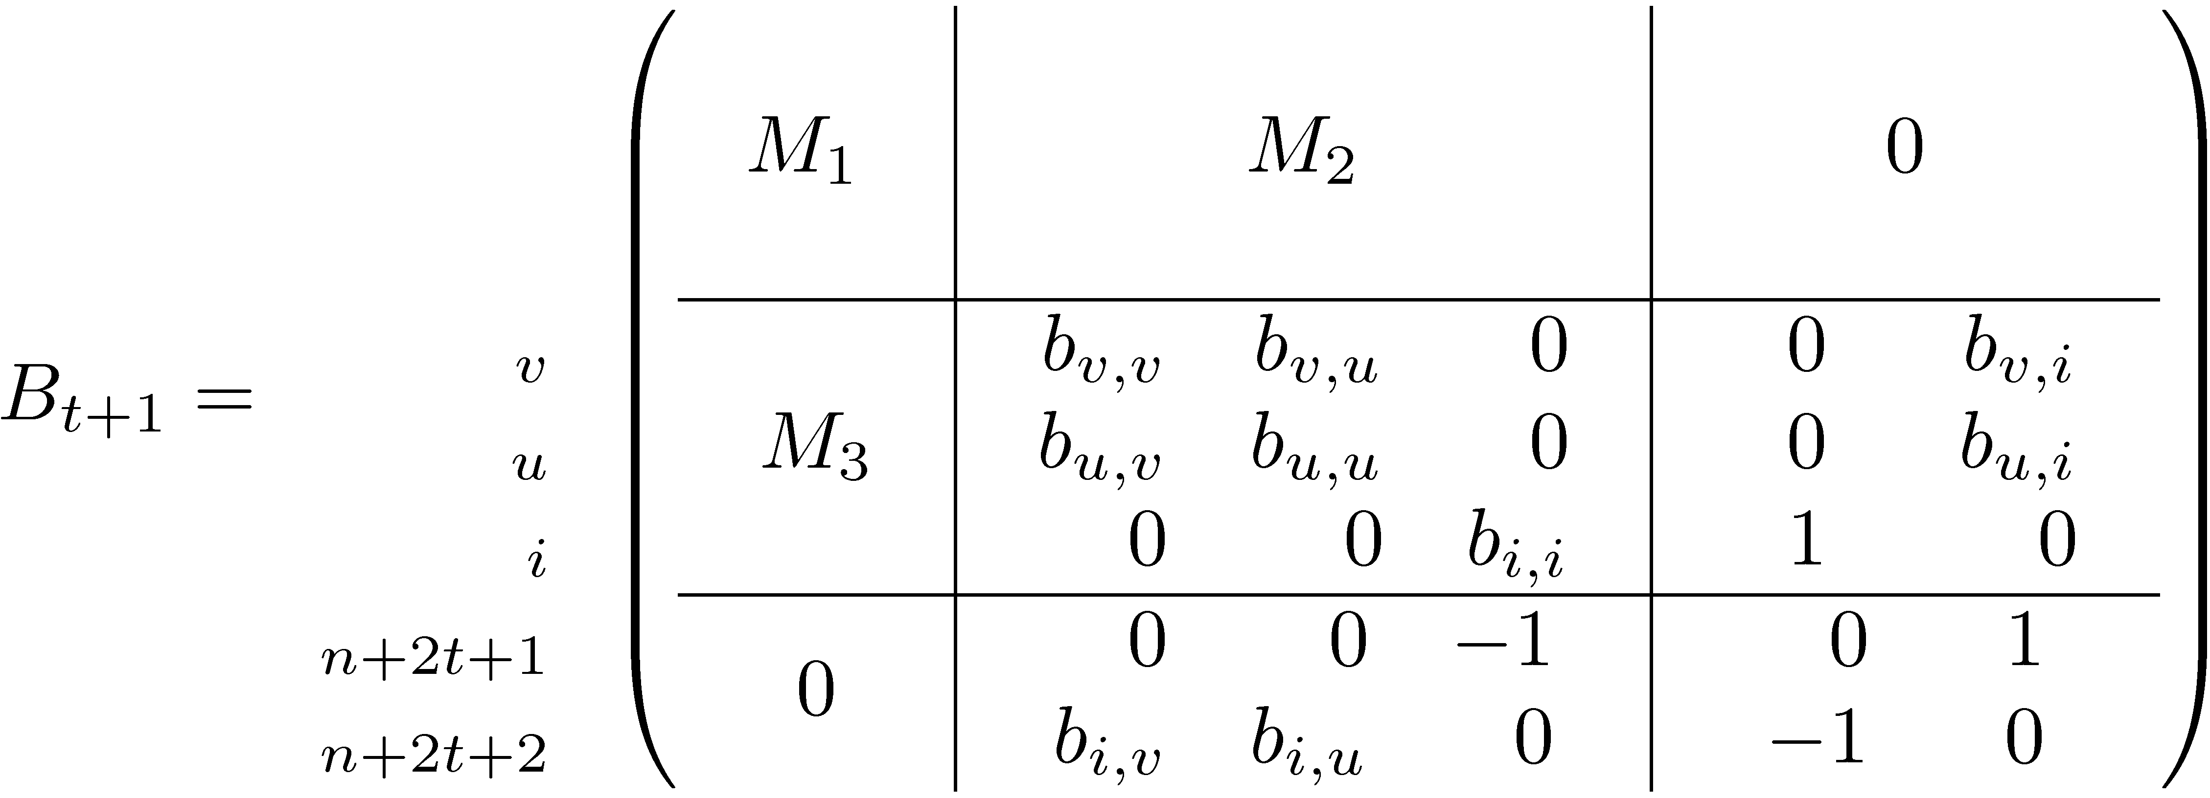
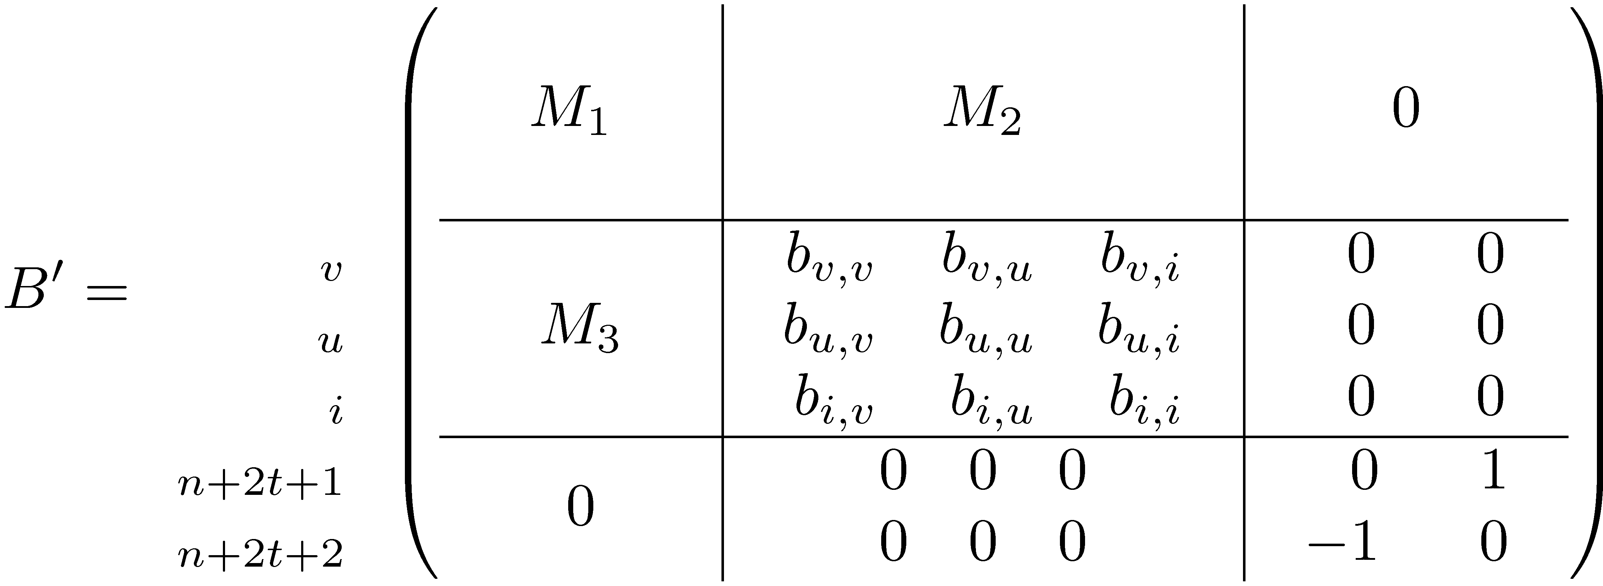
Sparsification algorithm – cont.
Consider the principal block defined by {i , u , v}:

Slide 13
What happens in the representing graph?
Recall the vertex splitting trick :
8, -6
56
7
…
9, 0*
13
8, -6
56
1, -1
1, -1
7
0
0
…
9, 0*
13

Slide 14
Separators
At the top level: partition A,B,C of the vertices of G so that |C| = O(n^{β}) |A|, |B| < αn No edges connect A and B .
Strong separator tree: recurse on A ∪ C and on B ∪ C .
Weak separator tree: recurse on A and on B .
A
B
C

Slide 15
Finding separators
Lipton-Tarjan (1979): Planar graphs have (O(n^{1/2}), 2/3)-separators. Can be found in linear time.
Alon-Seymour-Thomas (1990): H-minor free graphs have (O(n^{1/2}), 2/3)-separators. Can be found in O(n^{1.5}) time.
Reed and Wood (2005): For any ν>0, there is an O(n^{1+ν})-time algorithm that finds (O(n^{(2−ν)/3}) , 2/3)-separators of H-minor free graphs.

Slide 16
Obstacle 1: preserving separators
Can we perform the (labeled) vertex splitting and guarantee that the modified representing graph still has a β-separator tree ?
Easy for planar graphs and bounded genus graphs: just take the vertices u,v splitted from vertex i to be on the same face. This preserves the genus.
Not so easy (actually, not true!) that splitting an H-minor free graph keeps it H-minor free.
[Y. and Zwick - 2007] vertex splitting can be performed while keeping the separation parameter β (need to use weak separators). No “additional cost”.

Slide 17
Splitting introduces a K₄-minor

Slide 18
Main technical lemma
Suppose that (O(n^{β}),2/3)-separators of H-minor free graphs can be found in O(n^{γ})-time.
If G is an H-minor free graph, then a vertex-split version G’ of G of bounded degree and an (O(n^{β}),2/3)-separator tree of G’ can be found in O(n^{γ}) time.

Slide 19
Running time

Slide 20
Obstacle 2: separators of BDB^{T}
We started with A for which G_{A} has a β-separator tree.
We used sparsification to obtain a matrix B with rank(B) = rank(A) + 2t for which G_{B} has bounded degree and also has a (weak) β-separator tree.
We can compute, in linear time, BDB^{T} where D is a chosen diagonal matrix. We do so because BDB^{T} is always pivoting-free (analogue of positive definite).
But what about the graph G_{C} of C= BDB^{T} ? No problem! G_{C} = (G_{B})² (graph squaring of bounded degree graph): k-separator => O(k)-separator.

Slide 21
Obstacle 3: rank preservation of BDB^{T}
Over the reals take D=I and use rank(BB^{T})=rank(B) and we are done.
Over other fields (e.g. finite fields) this is not so:
If D = diag(x₁,…,x_{n}) we are OK over the generated ring: rank(BDB^{T})=rank(B) over F[x₁,…,x_{n}] .
Can’t just substitute the x_{i}’s for random field elements and hope that w.h.p. the rank preserves!
rank(B)=2 in GF(3)
rank(BB^{T})=1 in GF(3)

Slide 22
Obstacle 3: cont.
rank(B)= n/2 in GF(p)
Prob. (rank(BDB^{T}))= n/2 is exponentially small
Solution: randomly replace the the x_{i}’s with elements of a sufficiently large extension field.
If |F|=q suffices to take extension field F ’ with q^{r} elements where q^{r} > 2n² . Thus r = O(log n).
Constructing F ’ (generating irreducible polynomial ) takes O(r² + r log q) time [Shoup – 1994].

Slide 23
Applications
Maximum matching in bounded-genus graphs can be found in O(n^{ω/2}) < O(n^{1.19}) time (rand.)
Maximum matching in H-minor free graphs can be found in O(n^{3ω/(3+ω)}) < O(n^{1.326}) time (rand.)
The number of maximum matchings in bounded-genus graphs can be computed deterministically in O(n^{ω/2+1}) < O(n^{2.19}) time

Slide 24
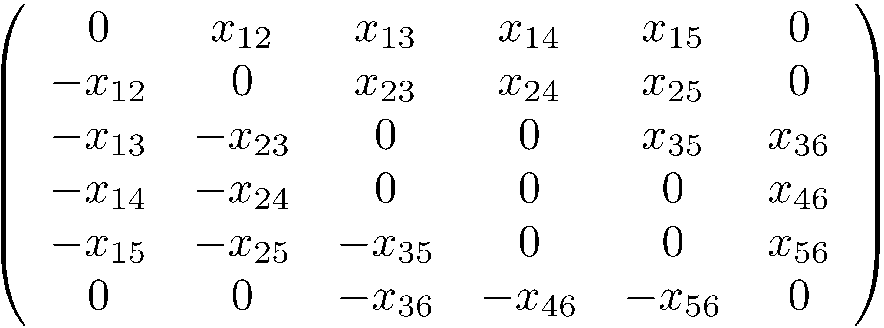
Tutte’s matrix (Skew-symmetric symbolic adjacency matrix)
4
1
6
3
2
5

Slide 25
Tutte’s theorem
Let G=(V,E) be a graph and let A be its Tutte matrix. Then, G has a perfect matching iff det A ≠0.
1
2
4
3

Slide 26
Tutte’s theorem
Let G=(V,E) be a graph and let A be its Tutte matrix. Then, G has a perfect matching iff det A ≠0.
Lovasz’s theorem
Let G=(V,E) be a graph and let A be its Tutte matrix. Then, the rank of A is twice the size of a maximum matching in G.

Slide 27
Why randomization?
It remains to show how to compute rank(A) (w.h.p.) in the claimed running time.
By the Zippel / Schwarz polynomial identity testing method, we can replace the variables x_{ij} in A_{s} with random elements from {1,…,R} (where R ~ n² suffices here) and w.h.p. the rank does not decrease.
By paying a price of randomness, we remain with the problem of computing the rank of a matrix with small integer coefficients.

Slide 28
Thanks

