Slide 1
Solving linear systems through nested dissection
Noga Alon Tel Aviv University
Raphael Yuster University of Haifa

Slide 2
Linear systems and elimination
Solving a linear system Ax=b is a fundamental algebraic problem with numerous applications.
Considerable effort devoted to obtaining algorithms that solve systems faster than the naive cubic implementation of Gaussian elimination.
[Hopcroft & Bunch (1974)]: G.E. of a matrix requires asymptotically the same number of operations as matrix multiplication.
Linear systems can be solved with algebraic complexity O(n^{ω}) where ω < 2.38 [Coppersmith & Winograd (1990)].

Slide 3
Sparse linear systems
Can we do better if the matrix is sparse having m << n² non-zero entries?
[Wiedemann (1986)] An O(nm) Monte Carlo algorithm for systems over finite fields.
[Spielman & Teng (2004)] Almost O(n) algorithm for approximately solving sparse symmetric diagonally-dominant linear systems.
Some other sporadic results.

Slide 4
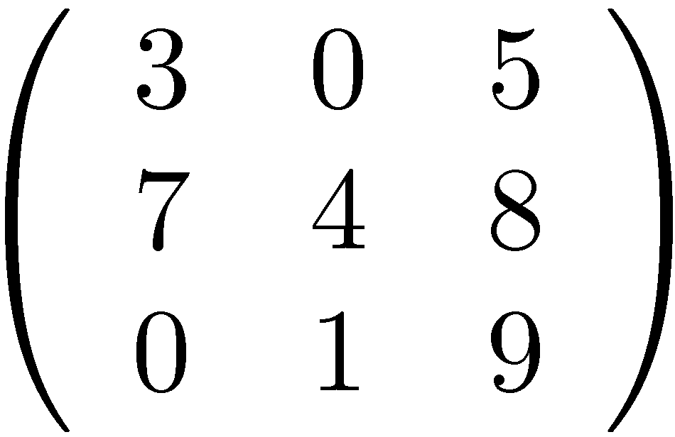
Structured matrices
In some important cases that arise in various applications, the matrix possesses structural properties in addition to being sparse.
Let A be an n × n matrix. The underlying graph denoted G_{A}, has vertices {1,…,n} where: for i ≠ j we have an edge ij iff a_{i,j} ≠ 0 or a_{j,i} ≠ 0.
G_{A} is always an undirected simple graph.

Slide 5
Nested dissection
[Lipton, Rose, Tarjan (1979)] Their seminal nested dissection method asserts that if A is - real symmetric positive definite and - G_{A} is represented by a β-separator tree then the system can be solved in O(n^{ωβ}) time.
For β < 1 this is better than general Gaussian Elimination.
Planar graphs and bounded genus graphs: β = ½ [separator tree constructed in O(n log n) time].
For graphs with an excluded fixed minor: β = ½ [separator tree constructed in O(n^{1+ε}) time Kawarabayashi & Reed (this conference)].

Slide 6
Nested dissection - limitations
Matrix needs to be:
Symmetric (or Hermitian),
Real (or Complex),
positive definite.
The method does not apply to matrices over finite fields, nor to real non-symmetric matrices nor to symmetric non positive definite matrices. In other words: it is not algebraically general.
Our main result: we overcome all of these limitations if we wish to compute solutions to non-singular linear systems.

Slide 7
Main result
Let Ax=b be a nonsingular linear system of dimension n over a field F.
If G_{A} has a β-separator tree then the unique solution of the system can be computed in O(n^{ωβ}) time.
Theorem 1
One needs to assume that a separator tree can be computed in O(n^{ωβ}) time.
β = ½ for planar graphs, bounded-genus graphs, fixed minor-free graphs.
Algorithm is randomized (Las Vegas) for fields with positive characteristic. Deterministic for Q,R,C.

Slide 8
Proof outline
We sketch for the case of the field R and for the case that G_{A} is (say) planar.
Some additional effort needed for general fields.
Some additional effort needed for general families of graphs having β-separator trees.

Slide 9
Rough idea: solve through the separator tree
At the top level: We have a partition X,Y,Z of the vertices of G_{A} so that |Z| = O(n^{½}) |X|, |Y| < ⅔n No edges connect X and Y.
(Weak) separator tree: obtained via recursion on X and on Y.
For the original system Ax=b start by finding solutions corresponding to the variables of Z (the root separator).
Construct systems A₁x=b₁ and A₂x=b₂ corresponding to the subgraphs X and Y that are consistent with the original system.
Solve recursively.
X
Z
Y

Slide 10
More details (part I): Some linear algebra
For a square matrix X the minor M_{ij}(X) is the determinant after removing row i column j. Denote: M_{i}(X)=M_{ii}(X).
Let c^{T}= (c₁,…,c_{n}) denote the solution to Ax=b.
Let B=[A|b] and let B_{i} = B – {column i}.
Cramer’s rule: c_{i} = ± det(B_{i})det(A)⁻¹.
Let Q=B^{T}B then (easy) det(B_{i})²=M_{i}(Q) and det(A)²=M_{n+1}(Q).
So, by computing the all minors M_{i}(Q) we obtain the squares of solutions c₁²,…,c_{n}².
Getting the solutions from their squares is easy.

Slide 11
Computing all minors quickly is the main difficulty.
To make life easier, let us assume that we can decompose Q as Q=LKL^{T} where L is unit lower triangular and K is diagonal.
Assuming such a decomposition we can prove:
Recall: our algorithm is recursive so p is not always n
Suppose Q=LKL^{T} is a matrix of dimension p. For t < p all the minors M_{t}(Q),…, M_{p}(Q) can be computed in O(m_{L}+(p-t)^{ω}) time, where m_{L} is the number of non-zeroes in L.
Lemma 1
The point is that we apply the lemma to values of t that are very large (close to p) so (p-t)^{ω} will be small.
m_{L} will always be negligible.

Slide 12
More details (part II): Matrix sparsification
Important tool used in the main result (Y. 2008):
Let A be a square matrix of order n with m nonzero entries. Another square matrix S of order n+2t can be constructed in O(m) time such that:
det(A)=det(S). Moreover M_{ij}(A)= M_{ij}(S) for i,j=1,…,n.
rank(S)=rank(A)+2t.
t=O(m).
Each row and column of S has at most three nonzero entries.
Lemma 2 – Sparsification Lemma

Slide 13
Why is sparsification useful?
Usefulness of sparsification stems from the fact that
Constant powers of S are also sparse.
SDS^{T} (where D is a diagonal matrix) is sparse.
This is not true for the original matrix A.
Over the reals we know that rank(SS^{T}) = rank(S) = rank(A)+2t and also that det(SS^{T}) = det(A)².
Since SS^{T} is symmetric, and positive semidefinite (over the reals), nested dissection may apply if we can guarantee that G_{SS}T has a good separator tree (guaranteeing this, in general, is not an easy task(. But it is quite easy for planar graphs:
If G_{A} is planar we can guarantee that so is G_{S}.
Since G_{A} is a bounded planar graph then G_{SS}T also has a β-separator tree [Mucha & Sankowski (2006)].

Slide 14
More details (part III): Nested dissection
We need the following minor generalization of the nested dissection algorithm of [Gilbert & Tarjan (1987)].
Let C be a symmetric positive definite matrix of order n with a bounded number of nonzero entries in each row and column, and assume that a (weak) β-separator tree for G_{C} is given (β ≥½).
Let w ∈ R^{n+1}. Let Q be obtained from C by adding w as a last row and column.
Then, a unit lower triangular matrix L and a diagonal matrix K can be constructed in O(n^{ωβ}) time so that Q=LKL^{T}.
Lemma 3

Slide 15
More details (part IV): Algorithm outline
We are given an n-dimensional system Ax=b where A is nonsingular and G_{A} is planar.
Part I: Reduction via matrix sparsification
Use Lemma 2 (Sparsification Lemma) to obtain a matrix S of dimension n+2t.
Expand b to a vector b’ of length n+2t as well (adding 2t zeroes).
Consider the n+2t-dimensional system Sx=b’.
It is not difficult to prove (using the matrix-minor preservation properties of sparsification and using Cramer’s rule) that the first n coordinates of the solution to Sx=b’ form the solution to Ax=b.

Slide 16
Part II: Recursive algorithm on a sparsified system
We can now assume that for our system Ax=b we have that G_{A} is planar and has bounded degree 3.
Let Z denote the vertices of G_{A} associated with the root separator in the separator tree of G_{A}.
Let N(Z) denote the neighbors of Z.
Assume that the vertices of Z ∪ N(Z) are bottom indices of A. Observe: |Z ∪ N(Z)| ≤ 4|Z| and hence their size is O(n^{½}).
Let C=A^{T}A. Very easy to compute C naively. Also G_{C} is the graph-square of G_{A} (has maximum degree 7). It has the same separator tree structure with neighborhood absorbed, and in particular, Z ∪ N(Z) is its root separator.
Let Q=B^{T}B where B=[A|b]. The only difference between C and Q is that Q has an additional row and column.

Slide 17
By Lemma 3: find a decomposition Q=LKL^{T} in O(n^{ω/2}) time.
By Lemma 1: Compute all the minors M_{i}(Q) for i ∈Z ∪ N(Z). Time required is O(|Z ∪ N(Z)|^{ω}) = O(n^{ω/2}).
Recall: from the M_{i}(Q) we can obtain the (squares of) solutions to variables corresponding to Z ∪ N(Z). What about the other variables?
Recursion: Replace all variables corresponding to Z ∪ N(Z) their actual computed values. This causes some equations to become shorter (or be eliminated), and also separates the system into two subsystems corresponding to the two parts of G_{C} separated by Z ∪ N(Z) .
Solve each subsystem recursively (many small issues inevitably neglected in this talk...).

Slide 18
Thanks

