Slide 1
A fast algorithm for Maximum Subset Matching
Noga Alon & Raphael Yuster

Slide 2
Maximum subset matching – definition
Input: graph G=(V,E) and subset S ⊂ V.
Goal: determine the maximum number of vertices of S that can be matched in a matching of G.
We denote this quantity by m_{G}(S)
Generalizes the maximum matching problem which corresponds to the case S=V and m_{G}(V)=2m(G).
Has practical applications.

Slide 3
m_{G}(S)=4
S
Not every maximum matching saturates the maximum possible number of vertices of S.
S
Not every matching that saturates m_{G}(S) vertices of S can be extended to a maximum matching.

Slide 4
Main result
Efficient randomized algorithm that computes m_{G}(S).
The running time is expressed in terms of : s = |S| m = |E(S,V-S)|
Note: There could be as many as Ɵ(s²) edges inside S, and hence G may have as many as Ɵ(m+s²) edges.
m=3 s=4
S

Slide 5
Let G=(V,E) be a graph and let S ⊂ V , where |S|=s and there are m edges from S to V - S. Then, there is a randomized algorithm that computes m_{G}(S) w.h.p. in time:
With ω < 2.38 [Coppersmith and Winograd 90] we get:

Slide 6
Comparison with previous algorithms
Maximum subset matching can be solved via any maximum weighted matching algorithm: Assign 2 the to edges inside S and 1 to the m edges from S to V-S. Clearly a maximum weighted matching has weight m_{G}(S).
The fastest weighted matching algorithm [Gabow and Tarjan 91] would run, in our case, in time O(n^{1/2}(m+s²)) .
For example: if m < s^{1.69} then this algorithm runs in O(s^{2.5}) while ours in O(s^{2.38}).

Slide 7
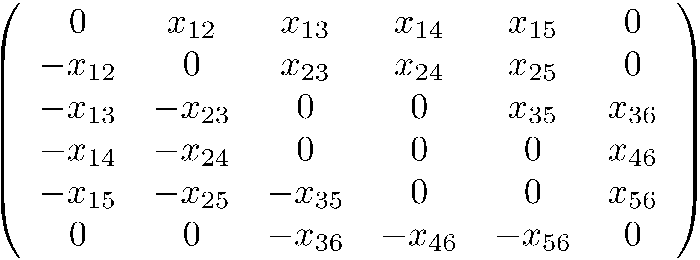
Tutte’s matrix (Skew-symmetric symbolic adjacency matrix)
The algorithm
4
1
6
3
2
5

Slide 8
The algorithm (cont.)
A Theorem of Lovász:
Let G=(V,E) be a graph and let A be its Tutte matrix. Then: 2m(G) = rank(A).
1
2
4
3

Slide 9
The algorithm (cont.)
We prove the following generalization:
Let G=(V,E) be a graph, S ⊂ V and let A_{S} be the s × n sub-matrix of A corresponding to the rows of S. Then: m_{G}(S) = rank(A_{S}).
Easy direction: m_{G}(S) ≤ rank(A_{S}). Add edges to G so that V - S becomes a clique and denote the new graph by G’. Clearly: rank(A’) =2m(G’) = n - s + m_{G}(S). Thus: rank(A_{s}) = rank(A’_{s}) ≥ rank(A’) - (n - s) = m_{G}(S).

Slide 10
The algorithm (cont.)
Other direction: m_{G}(S) ≥ rank(A_{S}). Suppose that rank(A_{S}) = r. We have to show that r vertices of S can be matched.
There is a non-singular r × r sub-matrix B of A_{s}.
Let the rows of B correspond to S’. It suffices to show that there is a matching covering the vertices in S’.
S
V-S
r = 3 S’={1,3,4} U ={1,4,9}
S

Slide 11
The algorithm (cont.)
In det(B) we get r! products (with signs). Each product corresponds to an oriented subgraph of G obtained by orienting, for each x_{ij} in the product, the edge from i (the row) to j (the column). This gives a subgraph in which the out-degree of every vertex of S’is 1 and the indegree of every vertex of U is 1.
S
V-S
r = 3 S’={1,3,4} U ={1,4,9}
S
1 4 3 9

Slide 12
The algorithm (cont.)
Any component is either a directed path, all of whose vertices are in S’ besides the last one which is in U-S’, or a cycle, all of whose vertices are in S’.
The crucial point now is that if there is an odd cycle in this subgraph, then the contribution of this term to det(B) is zero, as we can orient the cycle backwards and get the same term with an opposite sign.
As det(B) ≠ 0, there is at least one subgraph in which all components are either paths or even cycles, and hence there is a matching saturating all vertices in S’.

Slide 13
The algorithm (cont.)
It remains to show how to compute rank(A_{S}) (w.h.p.) in the claimed running time.
By the Zippel / Schwarz polynomial identity testing method, we can replace the variables x_{ij} in A_{s} with random elements from {1,…,R} (where R ~ n² suffices here) and w.h.p. the rank does not decrease.
By paying a price of randomness, we remain with the problem of computing the rank of a rectangular matrix with small integer coefficients.

Slide 14
The algorithm (cont.)
Some simple linear algebra:
If A is a real matrix then A^{T}A and A have the same kernel. In particular, rank (A^{T}A) = rank (A).
Proof: Suppose A^{T}Ax =0 then, using the scalar product, <Ax, Ax> = <A^{T}Ax , x> = 0 implying Ax = 0.
Notice that the assertion may fail for general fields, as can be seen, for instance, by the p × p matrix over F_{p}, all of whose entries are equal to 1.

Slide 15
The algorithm (cont.)
Hopcroft Bunch Algorithm:
We need the following result of [Hopcroft and Bunch 74] Gaussian Elimination requires asymptotically the same number of algebraic operations needed for matrix multiplication. Notice that a by-product of Gaussian elimination is the matrix rank.
Let A be an n × n matrix over a field. Then rank(A) can be computed using O(n^{ω}) algebraic operations. In particular, if a field operation requires Ɵ(K) time then rank(A) can be computed in O(Kn^{ω}) time.

Slide 16
The algorithm (cont.)
Computing A_{S}A_{S}^{T} :
s
n-s
s
m edges
s
A₂
×
B=A_{S}A_{S}^{T}
A₁
=
s
A₁^{T}
[Y. and Zwick 05] [Kaplan, Sharir, Verbin 06]
B=A₁A₁^{T}+A₂A₂^{T}
A₂^{T}
Õ(s^{ω})
Õ(s^{ω}) if m < s^{(ω +1)/2} Õ(ms^{(ω-1/2)}) if m ≥ s^{(ω +1)/2}

Slide 17
The algorithm (cont.)
It remains to compute rank(B) .
Since B is an s × s matrix this only requires O(s^{ω}) algebraic operations with Hopcroft Bunch Algorithm.
Careful! We cannot do arithmetic over the integers.
We do it over a large finite field F_{p}.
Since each element in B is Ɵ(n⁵) it suffices to take p as a random prime no greater than Ɵ(n⁶).
W.h.p. rank_{Fp}(B) = rank_{R}(B) .
The cost of an algebraic operation is only logarithmic.

Slide 18
Note
Computing rank(A_{s}) directly without computing A_{s}A_{s}^{T}, is costly.
The fastest algorithms for computing the rank of an s × n matrix directly require the use of Gaussian elimination, and can be performed using O(ns^{(ω +1)} ) algebraic operations.
Gaussian elimination cannot make use of the fact that the matrix is sparse (namely, in our terms, make use of m as a parameter to its running time).

Slide 19
Thanks

