Slide 1
Rainbow Decompositions
Raphael Yuster
University of Haifa
Proc. Amer. Math. Soc. (2008), to appear.

Slide 2
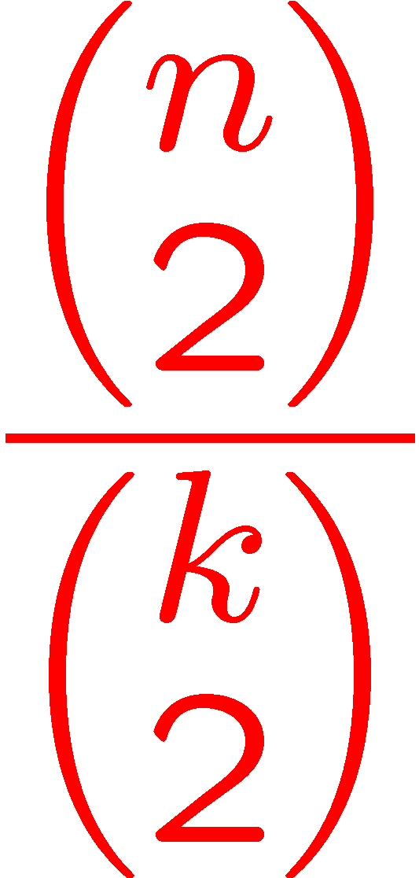
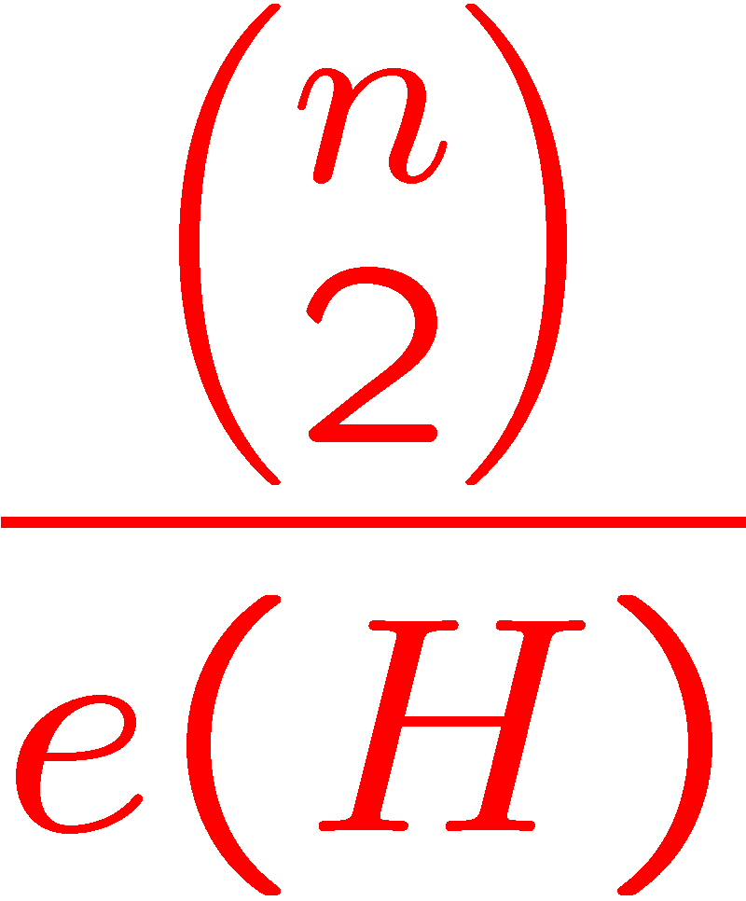
A Steiner system S(2,k,n) is a set X of n points, and a collection of subsets of X of size k (blocks), such that any two points of X are in exactly one of the blocks.
Example: n=7 k=3 { (123) (145) (167) (246) (257) (347) (356) }
Equivalently: K_{n} has a K_{k}-decomposition if K_{n} contains pairwise edge-disjoint copies of K_{k} .
More generally: for a given graph H we say that K_{n} is H-decomposable if K_{n} contains edge-disjoint copies of H.

Slide 3
Let gcd(H) denote the largest integer that divides the degree of each vertex of H.
Two obvious necessary conditions for the existence of an H-decomposition of K_{n} are that: e(H) divides gcd(H) divides n-1
Not always sufficient: K₄ is not K_{1,3} – decomposable. More complicated analysis shows that K₁₆, K₂₁, K₃₆, do not have a K₆-decomposition.
A seminal result of Wilson:
H-divisibility conditions
If n > n₀(H) then the H-divisibility conditions suffice.

Slide 4
A rainbow coloring of a graph is a coloring of the edges with distinct colors.
An edge coloring is called proper if two edges sharing an endpoint receive distinct colors. There exists a proper edge coloring which uses at most Δ(G)+1 colors (Vizing).
Extremal graph theory: conditions on a graph that guarantee the existence of a set of subgraphs of a specific type (e.g. Ramsey and Turán type problems).
Rainbow-type problems: conditions on a properly edge-colored graph that guarantee the existence of a set of rainbow subgraphs of a specific type.
Many graph theoretic parameters have rainbow variants.

Slide 5
Is Wilson’s Theorem still true in the rainbow setting?
Our main result:
We note that the case H=K₃ is trivial … However, already for H=K₄ existence of H-decomposition does not imply existence of rainbow H-decomposition. (a properly edge-colored K₄ need not be rainbow colored)
The proof of is based on a double application of the probabilistic method and additional combinatorial arguments.
For every fixed graph H there exists n₁=n₁(H) so that if n > n₁ and the H-divisibility conditions apply then a properly edge-colored K_{n} has an H-decomposition so that each copy of H in it is rainbow colored.

Slide 6
Let F be a set of positive integers. K_{n} is F-decomposable if we can color its edges so that each color induces a K_{k} for some k ∈ F.
Let H be a fixed graph, and let t be a positive integer. F is called an (H,t)-CDS if:
If k ∈ F then k ≥ t and K_{k} is H-decomposable.
There exists N such that for all n > N, K_{n} is H-decomposable if and only if K_{n} is F-decomposable.
Proof is a (non-immediate) corollary of a generalized Wilson Theorem for graph families.
Lemma 1
Let H be a fixed graph, and let t be a positive integer. then an (H,t)-CDS exists.

Slide 7
A properly colored forest T will be called a weed if it contains three distinct edges e₁,e₂,e₃, so that for each e_{i} there is an edge f_{i} ∉ { e₁, e₂, e₃ } having the same color as e_{i} and it is minimal with this property.
Notice: every weed has at most 6 and at least 4 edges.
Up to color isomorphism, there are precisely :
1 weed with 4 edges,
8 weeds with 5 edges,
41 weeds with 6 edges.

Slide 11
A properly edge-colored graph is called multiply colored if no color appears only once .
Proof (beginning…): If some color appears 4 times in G then it forms a matching with 4 edges which is the weed W₁. Otherwise, suppose that some color c appears 3 times in the edges (v₁,v₂), (v₃,v₄), (v₅,v₆). Since 6 vertices induce at most 15 edges, there is some edge (x,y) colored with c', and x ∉ {v₁,v₂,v₃,v₄,v₅,v₆}. Let (w,z) be another edge colored with c'. Since the coloring of G is proper, the 5 edges (v₁,v₂), (v₃,v₄), (v₅,v₆), (x,y), (w,z) form a weed. …
Lemma 2
Every multiply colored graph with at least 29 edges contains a weed.
11

Slide 12
Cannot improve 29 to 15

Slide 13
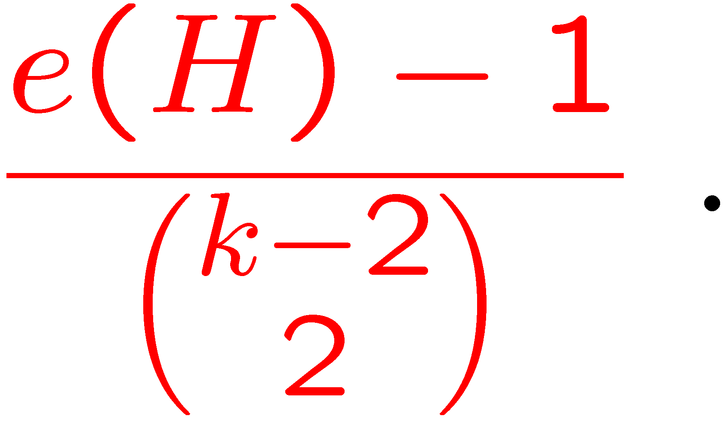
Lemma 3
For fixed r and H there is a constant C=C(r,H) so that if k > C and K_{k} is H-decomposable, then for any given set of r edges there is an H-decomposition in which these edges appear in distinct copies.
Proof:
Fix an H-decomposition of K_{k}, denoted L.
π ∈ S_{k} defines defines L_{π}.
Let U be a set of r edges.
For a randomly chosen π the probability that two non adjacent edges of U are in the same copy of H in L_{π} is at most

Slide 14
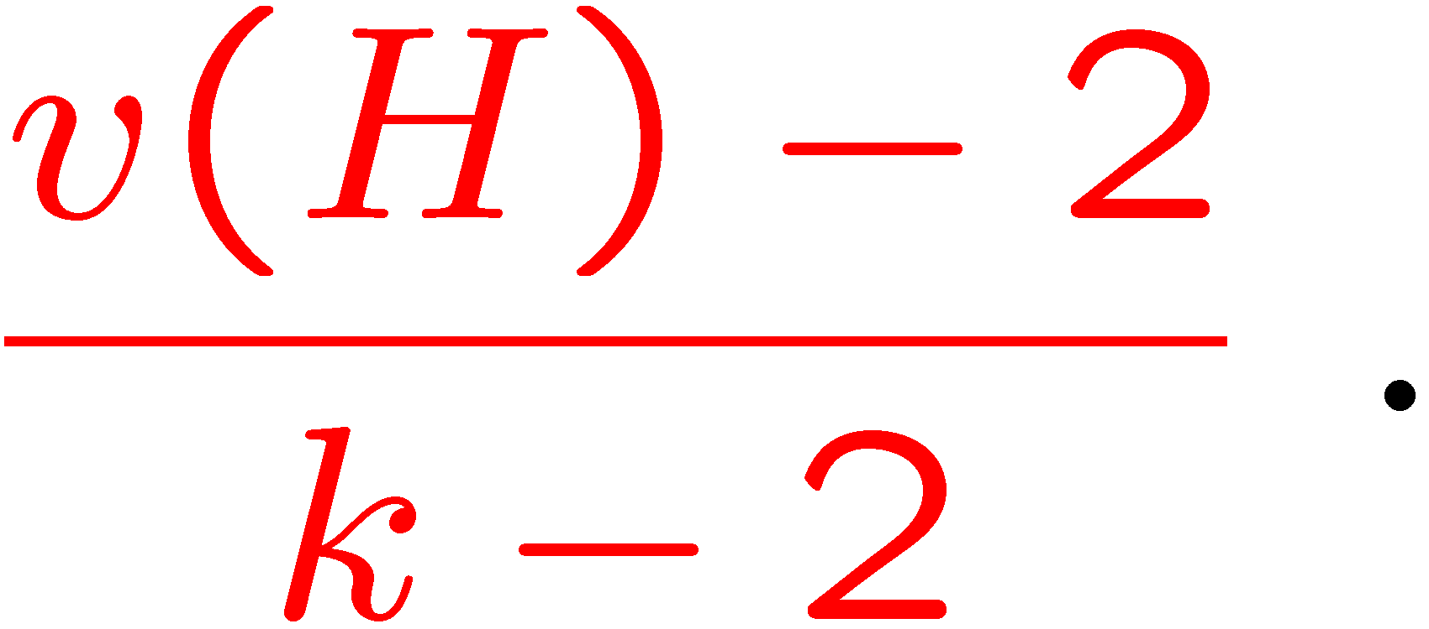
The probability that two adjacent edges of U are in the same copy of H in L_{π} is at most
As there are possible pairs of edges of U, we have that, as long as with positive probability, no two elements of U appear together in the same H-copy of L_{π}.
Since for large enough k as a function of r and H, the last inequality holds, the lemma follows.

Slide 15
Lemma 4
For a set of positive integers F there exists M=M(F) so that for every n > M, if K_{n} is a properly edge colored and F-decomposable, then K_{n} also has an F-decomposition so that every element of the decomposition contains no weed.
Proof:
Too long to be shown here (probabilistic arguments as well).

Slide 16
Completing the proof of the main result:
Fix a graph H, and let t=C(28,H) be the constant from Lemma 3.
Let F be an (H,t)-CDS, whose existence is guaranteed by Lemma 1.
Let M=M(F) be the constant from Lemma 4.
For every fixed graph H there exists n₁=n₁(H) so that if n > n₁ and the H-divisibility conditions apply then a properly edge-colored K_{n} has an H-decomposition so that each copy of H in it is rainbow colored.
For fixed r and H there is a constant C=C(r,H) so that if k > C and K_{k} is H-decomposable, then for any given set of r edges there is an H-decomposition in which these edges appear in distinct copies.
For a set of positive integers F there exists M=M(F) so that for every n > M, if K_{n} is a properly edge colored and F-decomposable, then K_{n} also has an F-decomposition so that every element of the decomposition contains no weed.

Slide 17
Since F is an (H,t)-CDS, there exists N=N(F) so that for all n > N, K_{n} is H-decomposable iff K_{n} is F-decomposable.
For all n sufficiently large that satisfy the H-divisibility conditions, consider a properly edge-colored K_{n}.
By Wilson’s Theorem K_{n} is H-decomposable.
By the definition of F, K_{n} is also F-decomposable.
By Lemma 4, there is also an F-decomposition so that every element of the decomposition contains no weed.
Consider some K_{k} element of such an F-decomposition. Thus, k ∈ F and hence k ≥ t and K_{k} is H-decomposable.

Slide 18
Let U be a maximal multiply colored subgraph of K_{k}.
Since K_{k} contains no weed, we have, by Lemma 2 that |U| < 29. Since k ≥ t = C(28,H) we have, by Lemma 3 that K_{k} has an H-decomposition so that no two edges of U appear together in the same H-copy of the decomposition.
But this implies that each copy of H in such a decomposition is rainbow colored.
Repeating this process for each element of the F-decomposition yields an H-decomposition of K_{n} in which each element is rainbow colored.

Slide 19
Thanks

