Slide 1
Reconstructing approximate phylogenetic trees from quartet samples
Raphael Yuster
Joint work with
Sagi Snir
SODA’10

Slide 2
The problem, formulation and definitions
The study of evolution and the construction of phylogenetic (evolutionary) trees are classical subjects in evolutionary biology.
One needs to assemble small, accurately inferred trees, into a large tree.

Slide 3
Important version of this task: quartet based reconstruction
in which all input trees are quartet trees (or simply quartets) - trees over 4 taxa.
The study of quartets is of prime importance as quartets are the smallest informational unit and hence, quartets play an important role in reconstruction methods (e.g. in works of Chor, Erdös, Jiang, Kearney, Li, Moret, Rao, Steel, Székely, Warnaw and others).

Slide 4
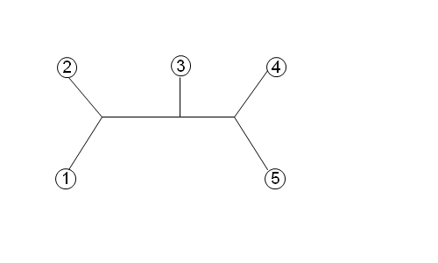
Phylogenetic trees: un-rooted full binary trees (all internal vertices have degree 3).
T:
L(T)={1,2,3,4,5}
Quartet: If we pick 4 taxa, throw away all other leaves, and vertices with degree 1 contract internal vertices of degree 2, we get a quartet on these taxa.
12|34
13|45

Slide 5
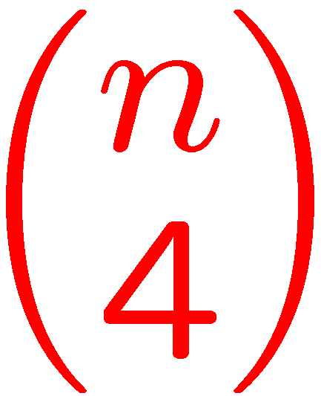
If |L(T)|=n then T has quartets (the full quartet set).
given a set of quartets the goal is to:
Not always doable: the given set may be inconsistent.
Examples:
S = {12|35 25|34 12|34 14|25}. This is inconsistent.
S = {12|35 13|45 12|34}. This is consistent.
construct a tree which satisfies the given quartets

Slide 6
Even when all quartets are consistent with some tree, finding such a tree is NP-hard [Steel 1992].
The general problem one wishes to approximate is maximum quartet consistency (MQC).
Even for consistent inputs, problem is open for many years best approximation ratio is the trivial 1/3, obtained naively by randomly assigning the taxa to the leaves.
There is a PTAS (J-K-L FOCS’98 ), for the case when all quartets exist in the input.
construct tree satisfying the max. number of quartets

Slide 7
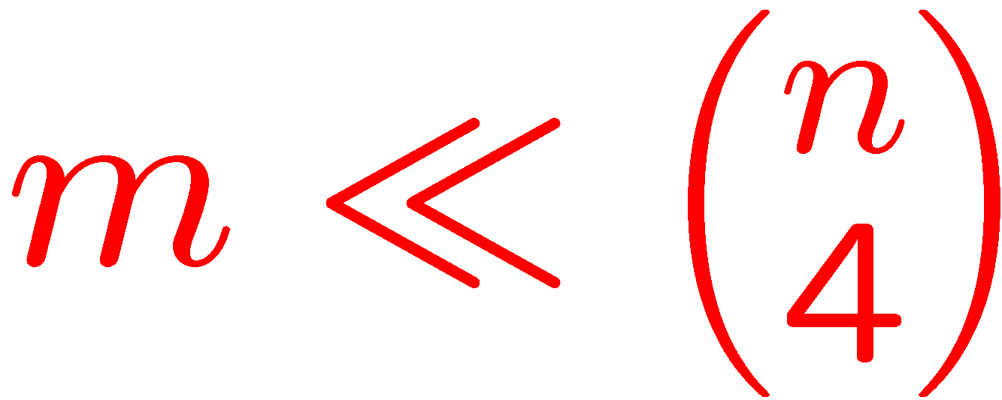
Generating a large set of correct quartets, based on biological data is time consuming.
Preparing a large input (moreover a complete input of quartets) may impractical even for small datasets.
A faster approach (sampled MQC) is to:
sample four-taxa sets,
Provide as input the m quartets they define,
solve MQC on this input.

Slide 8
Main result
New approximation algorithm for sampled MQC:
Given a set of m quartets sampled uniformly from the full quartet set (of some unknown tree), our algorithm achieves an approximation ratio ~ 0.47.
First algorithm to improve upon the trivial 1/3.
Actual implementation suggests that the algorithm performs much better than the theoretical lower bound: (close to 100% of the quartets are satisfied).

Slide 9
Another main result
A randomized PTAS for dense MQC instances:
Given a set of m = θ(n⁴) quartets (not necessarily consistent) – we construct a tree that satisfies
(1-ε)OPT quartets.

Slide 10
The quartets max-cut (QMC) algorithm
QMC is a divide and conquer algorithm:
Operates on the taxa set by partitioning it into parts.
Operate on the sub problems induced by each part
Merges the sub-solutions into a complete solution.
Let Q be a set of quartets with |Q|=m.
In this talk we consider partitions P into two parts.

Slide 11
ab|cd ∈Q is unaffected by a partition P, if all {a,b,c,d} are in one part of P.
ab|cd is satisfied by P if some part contains precisely a and b, or some part contains precisely c and d.
ab|cd is violated by P if some part contains a,c or a,d or b,c or b,d and the other part contains the other two.
Otherwise, some part contains only one of {a,b,c,d} In this case ab|cd is deferred.
a b c d
a b
c d
a c
b d
a b c
d

Slide 12
At every step of the algorithm, some quartets are satisfied, some violated, and some continue to the next steps (i.e. either deferred or unaffected).
A plausible strategy is to maximize the ratio between satisfied and violated quartets at every step.

Slide 13
Given the set of quartets Q over a taxa set X, we build a weighted (multi) graph G_{Q} =(X,E) with E as follows:
For every ab|cd ∈Q we add the 6 edges of the K₄ to E.
The “crossing” edges ac, ad, bc, bd receive weight 1. We call them good edges.
The bad edges ab, cd receive weight -2.
Observe that between two vertices in G_{Q} there can be good and bad edges simultaneously, originating from different quartets (think of G_{Q} as a weighted graph).
Denote E_{g} and E_{b} the good and bad edges, respectively.

Slide 14
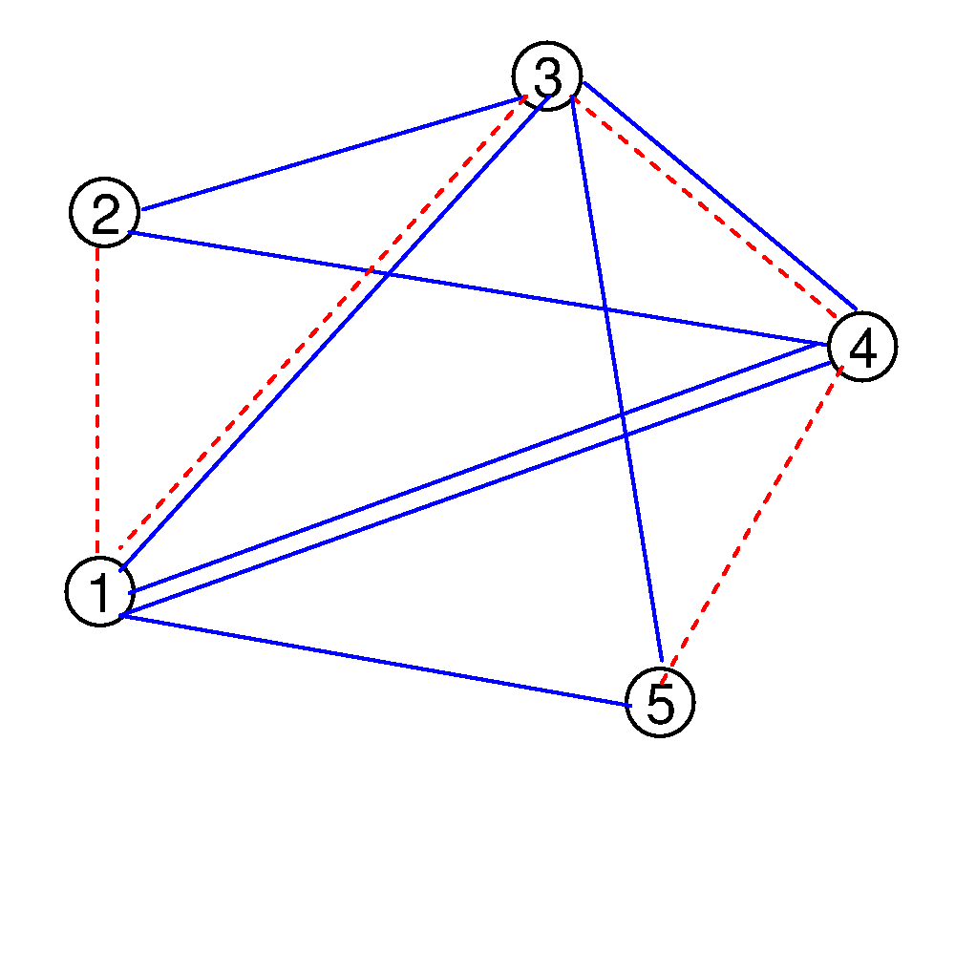
Q:
G_{Q}:
w(1,3)=-1 w(1,4)=2 w(4,5)=-2 w(1,5)=1

Slide 15
A cut in G_{Q} corresponds to a partition of the taxa set into two parts. Given a cut C=(S , X-S) in the graph:
A satisfied quartet contributes 4 good edges to the cut.
Total contributed weight: 4 .
A deferred contributes 2 good edges and 1 bad edge.
Total contributed weight: 0 .
A violated contributes 2 good edges and 2 bad edges.
Total contributed weight: -2.

Slide 16
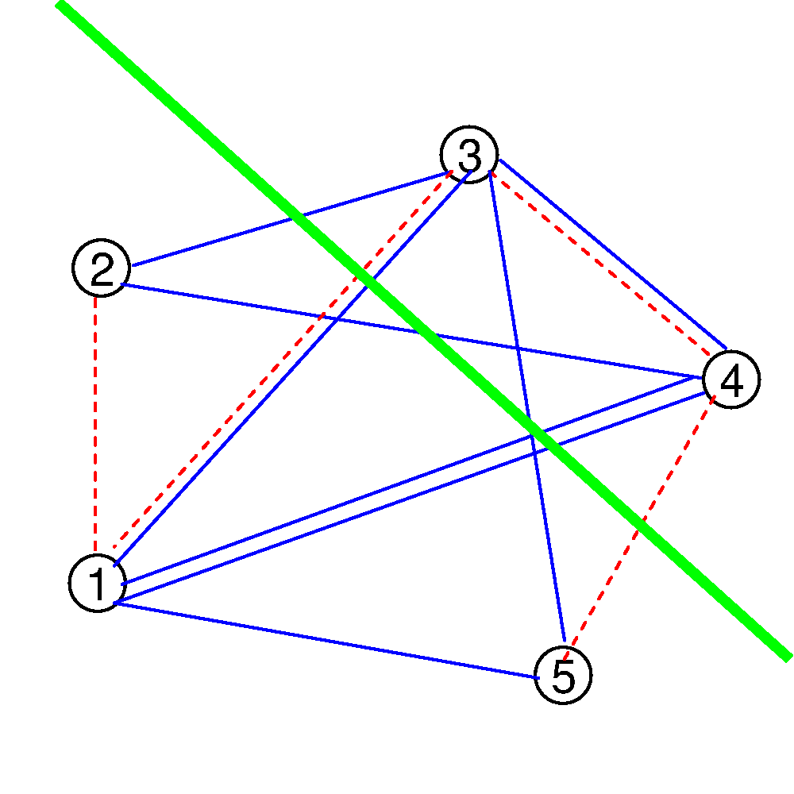
Q = { 12|34 , 13|45 }
G_{Q}:
The cut {125}, {34} satisfies 12|34 but violates 13|45.
Weight of this cut: (4)+(-2)=2

Slide 17
We want to find a cut C maximizing |E_{g} ∩ E_{C}| - α |E_{b} ∩ E_{C}| (recall that we have chosen α=2).
We need a good max-cut (approximation) algorithm that handles negative weight edges.
But before that: can we prove a rigorous lower bound on the weight of the max-cut in G_{Q} ?
Recall that our m input quartets are randomly generated quartets that are consistent. Let T denote some (unknown) tree satisfying them.

Slide 18
Recall that T is an unrooted phylogenetic tree (internal vertices have degree 3).
It is a well-known (easy) fact that such trees have an edge (a split) whose deletion partitions the taxa set X into two parts X₁ , X₂ each having size at least n/3.
Say, |X₁| = βn and ¹/₃ ≤ β ≤ ½.
|X₁|=3 β=3/7

Slide 19
Lemma 1
If C is a cut in G_{Q} that corresponds to a split then E[w(C)] ≥ 32m/27.
Proof: Q_{u} - the quartets unaffected by C. Q_{d} - the quartets deferred by C. Q_{s} - the quartets satisfied by C.
Q = Q_{u} ∪ Q_{d} ∪ Q_{s} .
w(C) = 0|Q_{u}| + 0|Q_{d}| + 4| Q_{s} | .
E[|Q_{u}|] = m( β⁴ + (1-β)⁴ ) . E[|Q_{d}|] = 4m( β(1- β)³ + β³(1-β) ) . E[|Q_{s}|] = 6m( β²(1- β)² ) .
E[w(C)] = 24m( β²(1- β)² ) . Now use ¹/₃ ≤ β ≤ ½.

Slide 20
Recall that the Goemans-Williamson max-cut algorithm has approximation ratio γ > 0.878 assuming the graph has nonnegative weights.
Lemma 2 – GW with negative weights
Let G be a weighted graph: Let M denote the value of the maximum cut Let N denote the absolute sum of the negative weights.
Then, the algorithm returns a cut whose value is at least γ M – (1- γ)N ~ 0.878 M - 0.122 N .
In the case of G_{Q} there are 2m bad edges and hence N=4m .

Slide 21
Corollary 3
In polynomial time, we find a cut C_{GW} in G_{Q} whose expected weight E[w(C_{GW})] is at least 0.552m.
Proof: By Lemma 1, the expected max-cut in G_{Q} is M ≥ 32m/27. By Lemma 2, using GW, we can find a cut whose value is at least 0.878 M - 0.122×(4m) ≥ 0.552m .
But we are interested in satisfying quartets, not in obtaining large cuts in G_{Q} .What is the correlation?
Also, C_{GW} does not necessarily correspond to a split, so there may be quartets violated by C_{GW} . How many?

Slide 22
Lemma 4
E[ |Q_{v}(C_{GW})| ] ≤ 2 E[ |Q_{s}(C_{GW})| ] – 0.276m.
Proof: Recall that a violated quartet contributes -2 to the cut and a satisfied quartet contributes +4. Hence: w(C_{GW}) = 4 |Q_{s}(C_{GW})| - 2 |Q_{v}(C_{GW})| . Putting expectations on both sides and using E[w(C_{GW})] ≥ 0.552m (Corollary 3) the result follows.
What about Q_{d}(C_{GW}) (deferred) & Q_{u}(C_{GW}) (unaffected)?
C_{GW} partitions the taxa set X into {X₁, X₂}.
An unaffected has all its four elements in the same part.
A deferred has one in one part and the others in another.

Slide 23
Suppose we create trees T₁ with |X₁| leaves and T₂ with |X₂| leaves and randomly assign X_{i} to the leaves of T_{i} .
We will satisfy (expectation) ¹/₃ of Q_{d}(C_{GW}) ∪ Q_{u}(C_{GW}) while Q_{v}(C_{GW}) and Q_{s}(C_{GW}) remain intact.
Lets examing the value of
T₁
T₂
T_{QMC} :

Slide 24
E[ |Q_{s}(T_{QMC})| ] =
E[ |Q_{s}(C_{GW})| ] + ¹/₃E[ |Q_{d}(C_{GW}) ∪ Q_{u}(C_{GW})| ] =
E[ |Q_{s}(C_{GW})| ] + ¹/₃E[ m - |Q_{v}(C_{GW})| - |Q_{s}(C_{GW})| ] =
¹/₃ m + ²/₃E[ |Q_{s}(C_{GW})| ] - ¹/₃E[ |Q_{v}(C_{GW})| ] ≥
( By Lemma 4: 2E[ |Q_{s}(C_{GW})| ] - E[ |Q_{v}(C_{GW})| ] ≥ 0.276m so: )
¹/₃ m + 0.276m/3 = 0.425m .

Slide 25
Thanks

