Slide 1
Packing cliques in graphs with independence number 2
Raphael Yuster
University of Haifa
Combinatorics, Probability, and Computing (2007), to appear.

Slide 2
G - graph with α(G) = 2.
Question: How many edges of G can be packed with edge-disjoint copies of K_{k} ?
f_{k}(n,m) – denotes the answer to the question for graphs with n vertices and m edges. Trivially we assume m ≥ n²/4 –n/2 .
Turán's Theorem + Wilson's Theorem yield f_{k}(n,m) = (1-o(1))n²/4 if m ≈ n²/4.
Conjecture of Erdős: Some recent problems and results in graph theory Discrete Math. 164 (1997), 81–-85. f₃(n,m) ≥ (1-o(1))n²/4 for all plausible m.

Slide 3
Best known lower bound: f₃(n,m) ≥ (1-o(1))n²/4.3 (Keevash + Sudakov 2004, [computer assisted])
For any ε > 0, conjecture was still open even if m < n²(¼ + ε).
Conjecture cannot be extended to general k.
It is not true that:
f_{k}(n,m) ≥ (1-o(1))n²/4 for all plausible m.
In particular, f_{k}(n,m) is not monotone.

Slide 4
α(G)=2
K_{k} has all its vertices in at most two classes.
Each K₇ has at least 9 of its edges inside classes.
There are at most 0.1n²/9 copies of K₇ packed.
Thus, f₇(n,0.3n²) < 21n²/90.

Slide 5
In view of these facts it is interesting to ask:
Is the generalization of the conjecture true for graphs whose density is greater than ½ ?
Our main result: Yes
For every k ≥ 3 there exists γ > 0 so that
f_{k}(n,m) ≥ (1-o(1))n²/4 for m ≤ n²( ¼+ γ ).

Slide 6
Contribution: (the case k=3)
conjecture
0.25
0.23
KS lowerbound
Density: ½ ¾ 1

Slide 7
Lemma 1: Simonovits stability theorem (parameterized):
Let G have α(G)=2 and ¼n²(1+ρ²) edges. Then, there exists a partition V = V₁ ∪ V₂ with
|V_{i}| > n/2-n(ρ² + ρ/2)
number of non-edges inside classes at most
(ρ³+1.5ρ⁴)n².

Slide 8
Lemma 2 (packing a sparse cut):
Let G be a bipartite graph with n vertices and ηn² edges. Let G' be the graph obtained from G by adding all possible edges inside the vertex classes.
Then: for n sufficiently large, there exists a set L of edge-disjoint K_{k} of G' so that
Furthermore, each element of L intersects both vertex classes.

Slide 9
Let ν_{k}(G) denote maximum number of disjoint K_{k} in G.
Let ν_{k}*(G) denote the fractional relaxation of that.
Clearly: 2m/(k(k-1)) ≥ ν_{k}*(G) ≥ ν_{k}(G).
Lemma 3 [Haxell & Rödl (Combinatorica 2001)]: [Y. (RS&A 2005)]:
Let G be a graph with n vertices. Then, ν_{k}*(G) ≤ ν_{k}(G)+o(n²).

Slide 10
Lemma 4 [Y. (JCTB 2005)]:
Let k > 2 be an integer. For n sufficiently large, every graph with n vertices and minimum degree at least n(1-k ⁻¹⁰) has a fractional K_{k}-decomposition.
In other words: ν_{k}*(G) = 2m/(k(k-1)).
Corollary 5:
Let k > 2 be an integer. For r sufficiently large, if G is obtained from K_{r} by deleting at most r-k edges with a common endpoint then G has a fractional K_{k}-decomposition.

Slide 11
Theorem 6: (of independent interest)
There exists ε₀= ε₀(k) > 0 so that for all ε < ε₀ : If G has at least n²(½ - ε) edges then G has a packing with edge-disjoint copies of K_{k} so that at most (2k-3) ε^{6/5}n²+o(n²) edges are unpacked.
(much better than greedy!)
Proof: r₀ = r₀(k) sufficiently large integer (to be chosen later). ε₀ = r₀⁻⁵. Given ε < ε₀ let r = ε ^{-1/5} . G has a decomposition L into n(n-1)/(r(r-1)) induced r-graphs (this is Wilson’s Theorem).

Slide 12
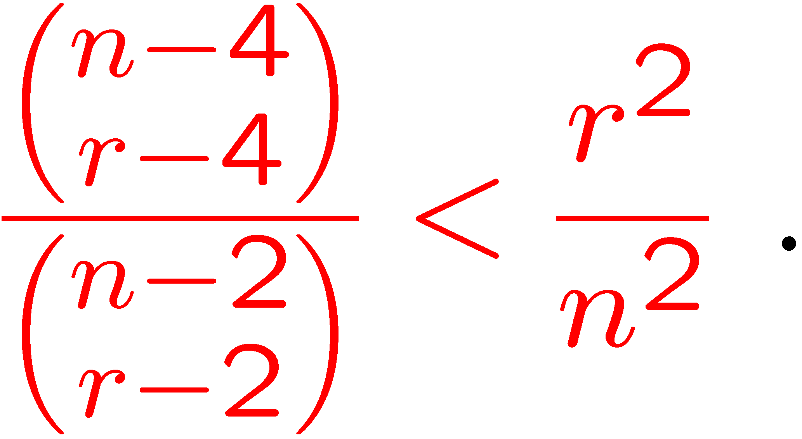
π∈ S_{n} be a permutation of V(G)={1,…,n}.
L → L_{π} means {v₁,…,v_{r}} ∈ L → {π (v₁),…, π(v_{r})} ∈ L_{π}
Choose π uniformly at random.
Let T be the non-edges of G. Notice that |T| < εn².
For t₁ , t₂ ∈ T sharing no endpoint, the probability that they are in the same element of L_{π} is precisely
Thus, the expected number of elements of L_{π} having two elements of T sharing no endpoint is less than

Slide 13
It follows that there exists an L where less than ε²r²n² elements of L have two independent non-edges.
L = L₁ ∪ L₂ ∪ L₃ ∪ L₄ where:
L₁ : elements with two or more independent non-edges.
L₂ : elements isomorphic to K_{r} - K₃.
L₃ : elements with one vertex with degree at most k-2 and all other vertices with degree at least r-2.
L₄ : elements with one vertex with degree at least k-1 and all other vertices with degree at least r-2.

Slide 14
L₁ : elements with two or more independent non-edges.
So, |L₁| < ε²r²n² and hence contains at most ε²r⁴n² edges.
L₃ : elements with one vertex with degree at most k-2 and all other vertices with degree at least r-2.
So, |L₃| < |T|/(r-k+1) < 2εn²/r.
Each element of L₃ contains a K_{r-1} and has a trivial fractional K_{k}-packing of value (r-1)(r-2)/(k(k-1)).
L₂ : elements isomorphic to K_{r} - K₃. L₄ : elements with one vertex with degree at least k-1 and all other vertices with degree at least r-2.
If r₀ is suff. large, each element in L₂ (by Lemma 4) and in L₄ (by Corollary 5) has fractional K_{k}-decomposition.

Slide 15
It follows that:
By Lemma 3, ν_{k}*(G) ≤ ν_{k}(G)+o(n²)
Recalling that r = ε ^{-1/5}, the number of edges not packed by an optimal K_{k}-packing is
as required.

Slide 16
Idea of proof:
Stability theorem guarantees some structure.
Cut edges are efficiently packed with a K_{k} packing L using Lemma 2.
Some (but not too many) of the elements of L are illegal; they use non-existing edges inside parts. Denote the legal part by L₀.
Each part is a complete graph missing some original edges, and some edges belonging to L₀, but this is still dense enough to use Theorem 6 on each part, getting packings L₁ and L₂.
Now L₀ ∪ L₁ ∪ L₂ yields the desired packing.

Slide 17
Thanks

