Slide 1
Almost exact matching
Raphael Yuster
University of Haifa

Slide 2
Exact Matching – definition
Given a graph G with some edges colored red, and an integer k, is there a maximum matching with exactly k red edges ?
Special case: Is there a perfect matching with k red edges ? This problem was first introduced by Papadimitriou and Yannakakis [JACM 82].
If we denote the matching number by m(G) then we are asking for a matching with k red edges and m(G)-k uncolored edges.

Slide 3
m(G) = 2
k=0 false
k=1 true
k=2 false

Slide 4
Exact Matching – computational status
Exact perfect matching is in RP (and in RNC: Mulmuley, Vazirani, and Vazirani [Combinatorica 87]).
It easily follows that:
exact matching is in RP.
Our first result:
Exact matching has an approximation with additive error of 1.
In a sense, this is as close as one can get to P without proving membership.

Slide 5
Exact Matching – computational status
Known to be in P for K_{3,3}-minor free graphs (also the counting problem). Little [74], Vazirani [Inf. Comput. 89].
Our second result:
The number of perfect exact matchings in K_{3,3}-minor free graphs can be computed in O(n^{3.19}) time. The number of perfect matchings in K_{3,3}-minor free graphs can be computed in O(n^{2.19}) time.

Slide 6
A randomized polynomial time algorithm
Reduce exact matching to exact perfect matching:
A graph G with n vertices and a parameter k are given.
Compute m(G).
Add n-2m(G) new vertices and connect each to V(G).
Solve exact perfect matching for new graph with same k.
n-2m(G)

Slide 7
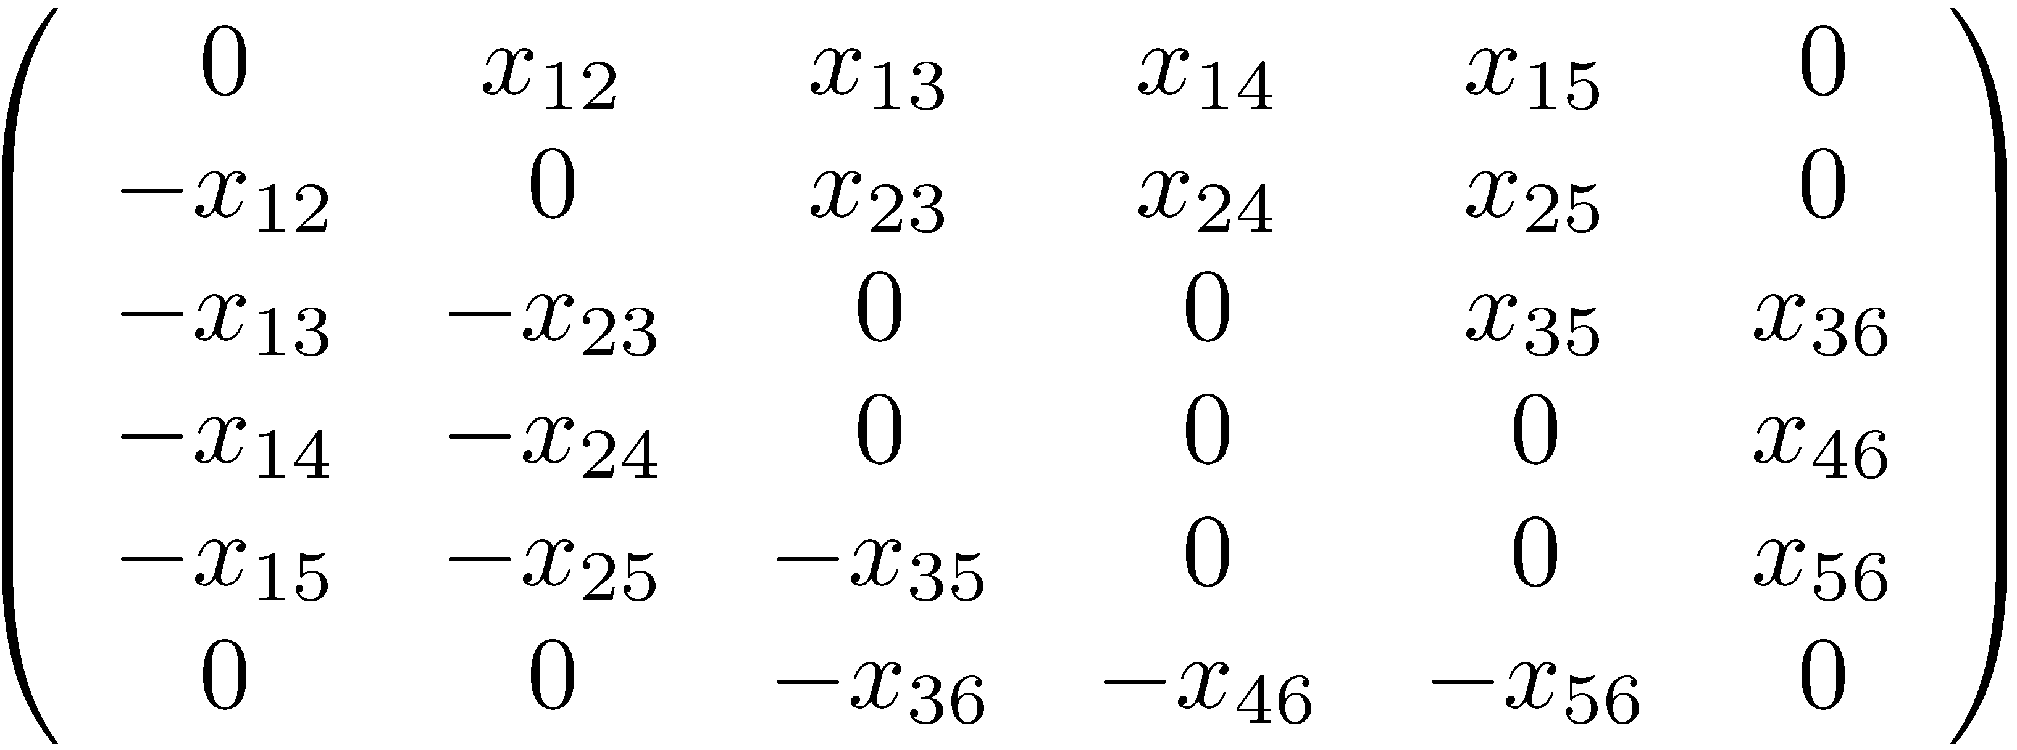
Tutte’s matrix (Skew-symmetric symbolic adjacency matrix)
A randomized polynomial time algorithm
4
1
6
3
2
5

Slide 8
A randomized polynomial time algorithm
Tutte’s theorem
Let G=(V,E) be a graph and let A be its Tutte matrix. Then, G has a perfect matching iff det A ≠ 0. In fact, there is a bijection between the terms of Pf A and the perfect matchings of G.
1
2
4
3

Slide 9
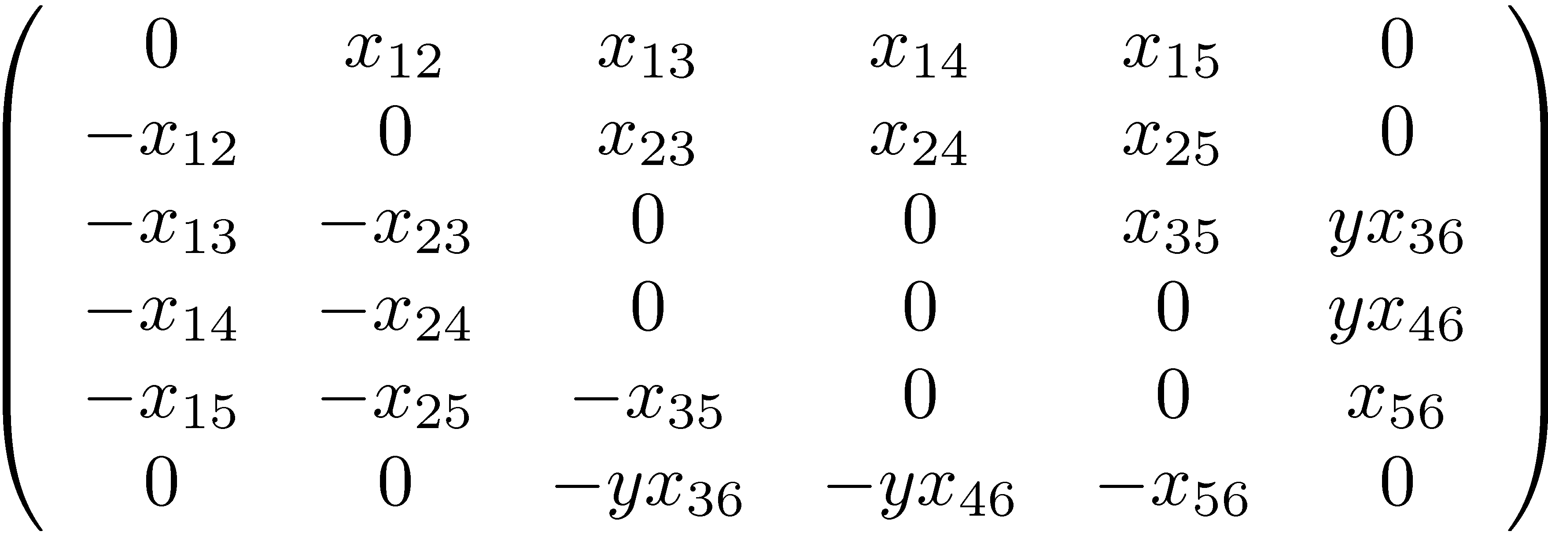
Red distigushing Tutte’s matrix
A randomized polynomial time algorithm
4
1
6
3
2
5

Slide 10
A randomized polynomial time algorithm
Extending Tutte’s theorem
Let G=(V,E) be a graph, R ⊂ E red edges, k an integer. Let A be its red distinguishing Tutte matrix. Then, G has an exact perfect matching iff the coefficient of y^{k} in Pf A is not zero.
1
4
2
3

Slide 11
A randomized polynomial time algorithm
By the Zippel / Schwarz polynomial identity testing method, we can replace the variables x_{ij} with random elements of a finite field F_{p} where p is polynomial in n, and w.h.p. if the coefficient of y^{k} is non-zero in the Pfaffian of the original matrix, it will also be non-zero in the new matrix (which only has one indeterminate, y). The determinant (and Pfaffian) of a matrix with one indeterminate can easily be computed in polynomial time.

Slide 12
An approximation algorithm for exact matching
Given a graph G with some red edges, and a parameter k
The algorithm will either:
correctly assert that there is no maximum matching with exactly k red edges,
exhibit a matching of size at least m(G)-1 and with exactly k red edges.

Slide 13
An approximation algorithm for exact matching
For convenience, assume non-red edges are blue.
A maximum matching M is called red-maximum if every other maximum matching contains at most as many red edges as M.
Finding a red-maximum matching can be done in polynomial time via general weighted matching algorithms (e.g. Gabow-Tarjan [JACM 91]):

Slide 14
An approximation algorithm for exact matching
Let m=m(G). Assign: to each blue edge the weight m to each red edge the weight m+1.
Notice that every maximum weighted matching must contain m edges.
Since the weight of red edges is larger than the weight of blue edges, every maximum weighted matching maximizes the number of red edges in it.

Slide 15
An approximation algorithm for exact matching
Let M_{R} and M_{B} be red-maximum and blue-maximum matchings, respectively.
If M_{R} contains less than k red edges, we are done. If M_{B} contains less than m-k blue edges, we are done.

Slide 16
An approximation algorithm for exact matching
Let U = M_{R} ∪ M_{B}.
U is considered as a spanning sub(multi)graph of G having maximum degree 2.
Each component of U is either: - an even length path (possibly a singleton vertex) - an even length cycle (cycles of length 2 in U are multiple edges having the same color. They are formed by edges that appear in both M_{R} and M_{B}).

Slide 17
An approximation algorithm for exact matching
A component S of U is of type (x,y,z) for x ≤ y ≤ z if 1) length(S)=2z, 2) one of the maximum matchings of S (that does not contain both end-edges in case S is a path) has x red edges 3) the other maximum matching has y red edges
Denote: min(S)=x, max(S)=y.
A path of type (2,3,4)
A cycle of type (2,3,4)

Slide 18
An approximation algorithm for exact matching
Enumerate the components of U by S₁ , … , S_{t} , and let
x_{i} = min(S_{i}) , y_{i} = max(S_{i}) , length(S_{i}) = 2z_{i} for i=1,…,t.
We have that:
z₁+ z₂ + … + z_{t} = m
Also notice that: In each component, one of the matchings is a subset of M_{R} and the complimentary matching is a subset of M_{B}, Hence:
x₁+ x₂ +… + x_{t} ≤ k ≤ y₁ + y₂ +… + y_{t}

Slide 19
An approximation algorithm for exact matching
f₀ = x₁ + x₂ + … + x_{t}
f₁ = y₁ + x₂ + … + x_{t}
f_{i} = y₁ +…+ y_{i} + x_{i+1} + … + x_{t}
f_{t} = y₁ + … + y_{t}
≤ k
≥ k
If some f_{i}=k we are done: From first i components S₁, … , S_{i} take the maximum matching with y_{j} = max(S_{j}) red edges. From remaining components S_{i+1}, … , S_{t} take the maximum matching with x_{j} = = min(S_{j}) red edges. Altogether: a maximum matching with k red edges.

Slide 20
An approximation algorithm for exact matching
Otherwise: Let i be such that f_{i-1} < k and f_{i} > k.
Thus, there is an integer p_{i} so that x_{i} < p_{i} < y_{i} and so that
y₁+ … + y_{i-1} + p_{i} + x_{i+1} + … + x_{t} = k.
From first i-1 components S₁, … , S_{i-1} take the maximum matching with y_{j} = max(S_{j}) red edges.
From components S_{i+1}, … , S_{t} take the maximum matching with x_{j} = min(S_{j}) red edges.
It remains to show that in S_{i} we can select z_{i}-1 independent edges, exactly p_{i} of which are red.

Slide 21
An approximation algorithm for exact matching
More generally, we show that if S is an even cycle or even path of type (x,y,z) and x < p < y, we can find in S a set of z-1 independent edges, exactly p of which are red.
In fact, if S is an even path we can actually find a matching of size z with exactly p red edges.
(For cycles, we may need to lose one edge …)

Slide 22
An approximation algorithm for exact matching
Best to demonstrate the proof by example:
A path of type (2,6,8)
For any p ∈ {2,3,4,5,6} we can find a matching with 8 edges, p of which are red

Slide 23
Thanks

