Slide 1
Long cycles, short cycles, min-degree subgraphs, and feedback arc sets in Eulerian digraphs
Raphael Yuster
joint work with
Asaf Shapira
Eilat 2012

Slide 2
Eulerian Digraph: A digraph in which the in-degree equals the
out-degree at each vertex.
Some properties of Eulerian digraphs:
  Can be decomposed into directed cycles.
  In every (A,B) cut, the number of arcs from A to B equals the number of arcs from B to A.
Girth: Length of shortest (directed) cycle.
Circumference: Length of longest (directed) cycle.
Minimum Cycle Decomposition: Minimum number of edge-disjoint cycles covering all the edges.
Feedback Arc Set: Smallest set of edges whose removal makes the digraph acyclic.
Largest minimum (semi)-degree subgraph: A subgraph with largest possible minimum (semi)-degree.

Slide 3
What can we say about these problems for Eulerian digraphs with n vertices and m arcs?
Most of these problems are well understood for undirected graphs. Except:
Why are these problems less understood for directed graphs?
  Subgraph of minimum degree m/n do not always exist.
  The DFS approach fails.
  Moore bound does not apply.
  Minimum feedback arc sets are nontrivial.
Most of the known results (there are too many to list) assume some minimum (in)degree requirement.
Cycle Decomposition: (Erdös-Goodman-Pósa - 1966)
Is it true that any graph can be edge-decomposed into O(n) cycles? (Note: it is easy to get O(n log n) )

Slide 4
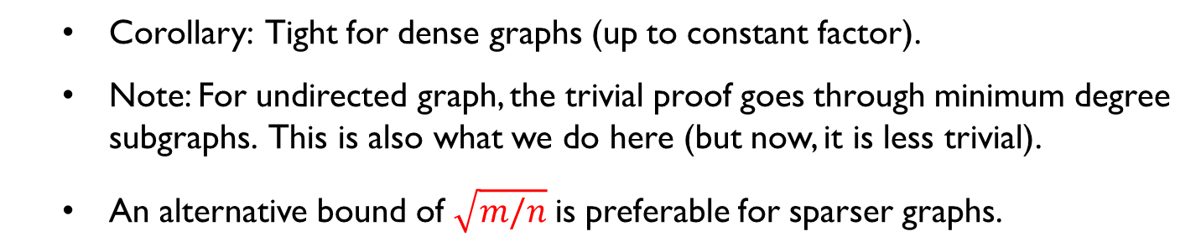
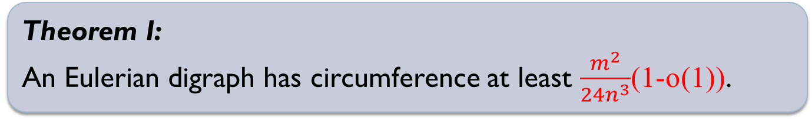
Concrete questions – and some answers
Cycle Decomposition Conjecture: (Bollobás-Scott, Dean)
An Eulerian digraph has a cycle decomposition with O(n) cycles.
Circumference Conjecture: (Bollobás-Scott)
An Eulerian digraph has a circumference Ω(m/n).
Theorem I:
An Eulerian digraph has circumference at least $\frac{m^{2}}{24n^{3}}$(1-o(1)).
Corollary: Tight for dense graphs (up to constant factor).
Note: For undirected graph, the trivial proof goes through minimum degree subgraphs. This is also what we do here (but now, it is less trivial).
An alternative bound of $\sqrt{m/n}$is preferable for sparser graphs.

Slide 5
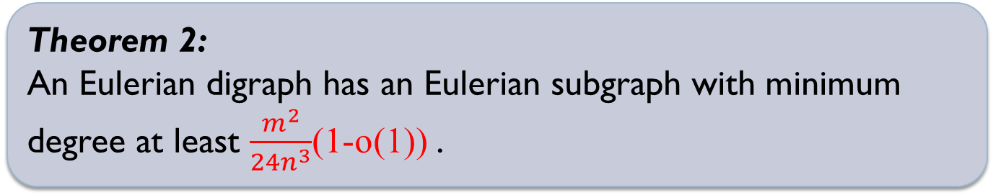
Concrete questions – and some answers
Theorem 2:
An Eulerian digraph has an Eulerian subgraph with minimum degree at least $\frac{m^{2}}{24n^{3}}$(1-o(1)) .
This turns out to be tight (for any density) up to a constant < 163.
m²/n²
m/n
n²/m
split each vertex of this part into n²/m copies (altogether these are n vertices) , and split the degree among the copies so that the degree now becomes m²/n³
Even if we settle for minimum
in-degree, we cannot hope for more

Slide 6
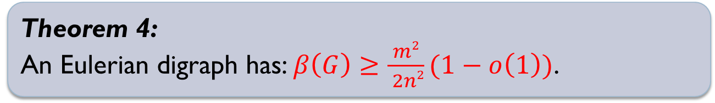
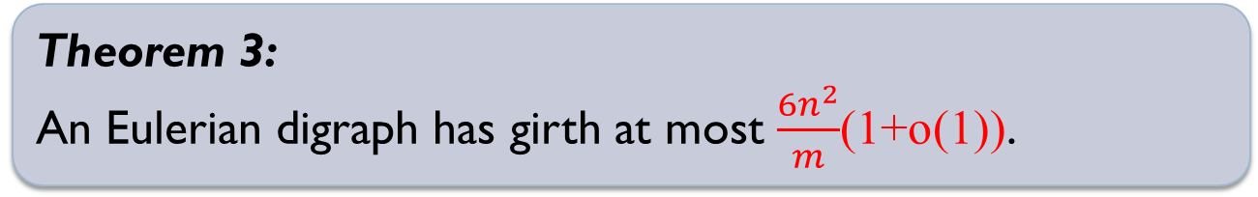
Concrete questions – and some answers
To prove Theorem 2, (and hence Theorem 1 on circumference) we actually need to consider the girth problem…
Theorem 3:
An Eulerian digraph has girth at most $\frac{6n^{2}}{m}$(1+o(1)).
This is tight up to the constant 6, for any density.
To prove Theorem 3, we need to consider the Feedback Arc Set problem. Denote by $β\left(G\right)$ the smallest FAS of G.
Theorem 4:
An Eulerian digraph has: $β\left(G\right)≥\frac{m2}{ 2n2}(1−o\left(1\right))\text{.}$
This is tight (and the constant 2 is optimal!) for any density.

Slide 7
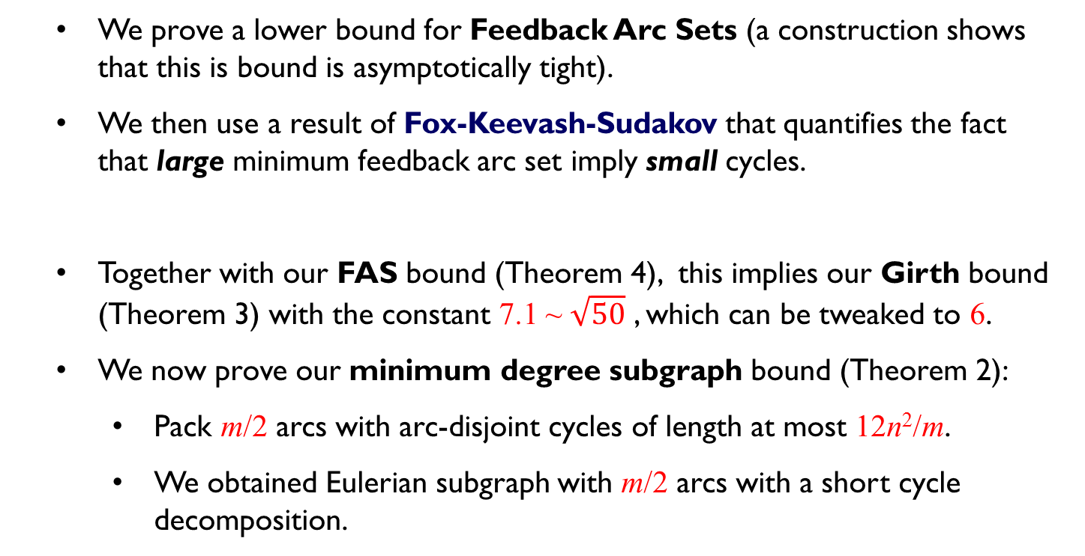
Proof chain
We prove a lower bound for Feedback Arc Sets (a construction shows that this is bound is asymptotically tight).
We then use a result of Fox-Keevash-Sudakov that quantifies the fact that large minimum feedback arc set imply small cycles.
  Together with our FAS bound (Theorem 4), this implies our Girth bound (Theorem 3) with the constant 7.1 ~ $\sqrt{50}$ , which can be tweaked to 6.
We now prove our minimum degree subgraph bound (Theorem 2):
    Pack m/2 arcs with arc-disjoint cycles of length at most 12n²/m.
    We obtained Eulerian subgraph with m/2 arcs with a short cycle decomposition.
Theorem (FKS) : If $β\left(G\right)>25n^{2}/r^{2}$ then girth(G) ≤ r.

Slide 8
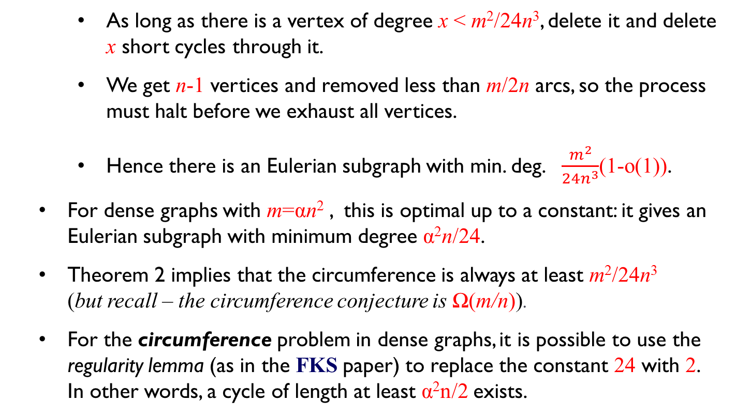
Proof chain (cont.)
    As long as there is a vertex of degree x < m²/24n³, delete it and delete x short cycles through it.
    We get n-1 vertices and removed less than m/2n arcs, so the process must halt before we exhaust all vertices.
    Hence there is an Eulerian subgraph with min. deg. $\frac{m^{2}}{24n^{3}}$(1-o(1)).
  For dense graphs with m=αn² , this is optimal up to a constant: it gives an Eulerian subgraph with minimum degree α²n/24.
  Theorem 2 implies that the circumference is always at least m²/24n³
  (but recall – the circumference conjecture is Ω(m/n)).
  For the circumference problem in dense graphs, it is possible to use the regularity lemma (as in the FKS paper) to replace the constant 24 with 2.
  In other words, a cycle of length at least α²n/2 exists.

Slide 9
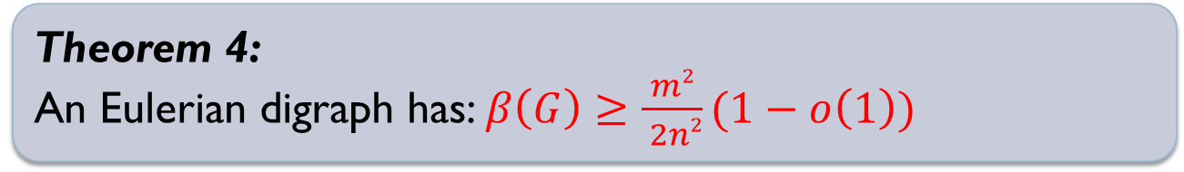
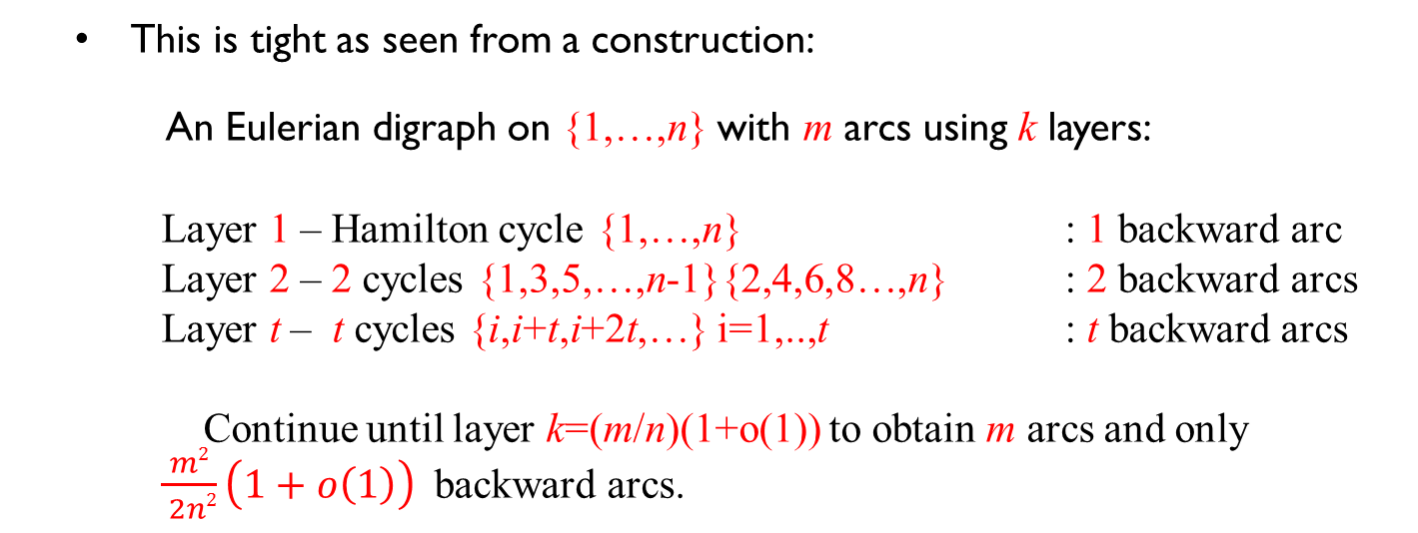
So we remain with the task of proving:
Theorem 4:
An Eulerian digraph has: $β\left(G\right)≥\frac{m2}{ 2n2}(1−o\left(1\right))$
This is tight as seen from a construction:
An Eulerian digraph on {1,…,n} with m arcs using k layers:
Layer 1 – Hamilton cycle {1,…,n} : 1 backward arc
Layer 2 – 2 cycles {1,3,5,…,n-1}{2,4,6,8…,n} : 2 backward arcs
Layer t – t cycles {i,i+t,i+2t,…} i=1,..,t : t backward arcs
Continue until layer k=(m/n)(1+o(1)) to obtain m arcs and only $\frac{m2}{ 2n2}\left(1+o\left(1\right)\right)$ backward arcs.

Slide 10
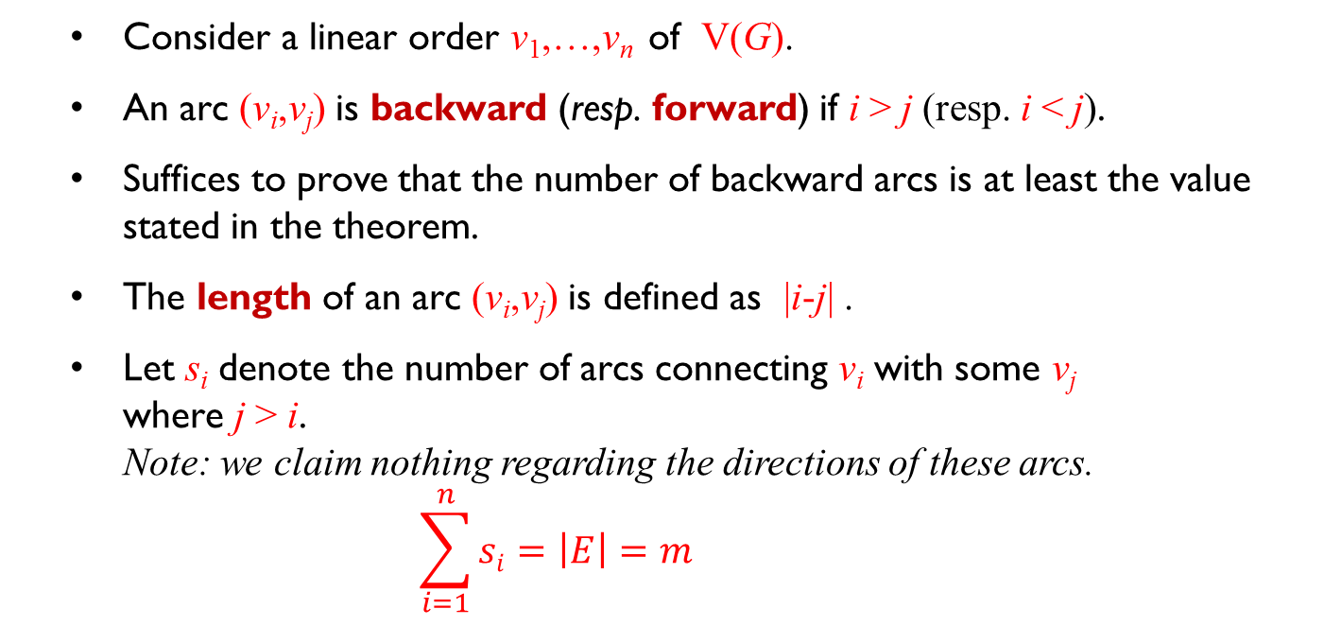
Proof sketch – short version
Consider a linear order v₁,…,v_{n} of V(G).
An arc (v_{i},v_{j}) is backward (resp. forward) if i > j (resp. i < j).
Suffices to prove that the number of backward arcs is at least the value stated in the theorem.
The length of an arc (v_{i},v_{j}) is defined as |i-j| .
Let s_{i} denote the number of arcs connecting v_{i} with some v_{j}
where j > i.
Note: we claim nothing regarding the directions of these arcs.
$$\sum_{i=1}^{n}{si}=\left|E\right|=m$$

Slide 11
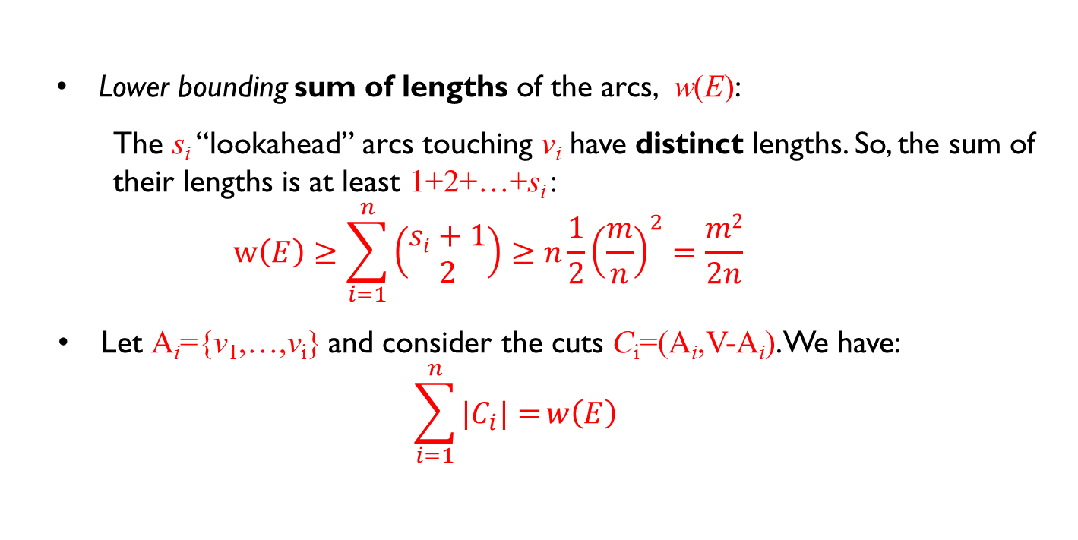
Proof sketch – short version (cont.)
Lower bounding sum of lengths of the arcs, w(E):
  The s_{i} “lookahead” arcs touching v_{i} have distinct lengths. So, the sum of their lengths is at least 1+2+…+s_{i} :
  $$w\left(E\right)≥\sum_{i=1}^{n}{\left(\begin{matrix}si+1 \\ 2\end{matrix}\right)}≥n\frac{1}{2}{\left(\frac{m}{n}\right)}^{2}=\frac{m2}{2n}$$
  Let A_{i}={v₁,…,v_{i}} and consider the cuts C_{i}=(A_{i},V-A_{i}). We have:
  $$\sum_{i=1}^{n}{|C_{i}|=}w\left(E\right)$$

Slide 12
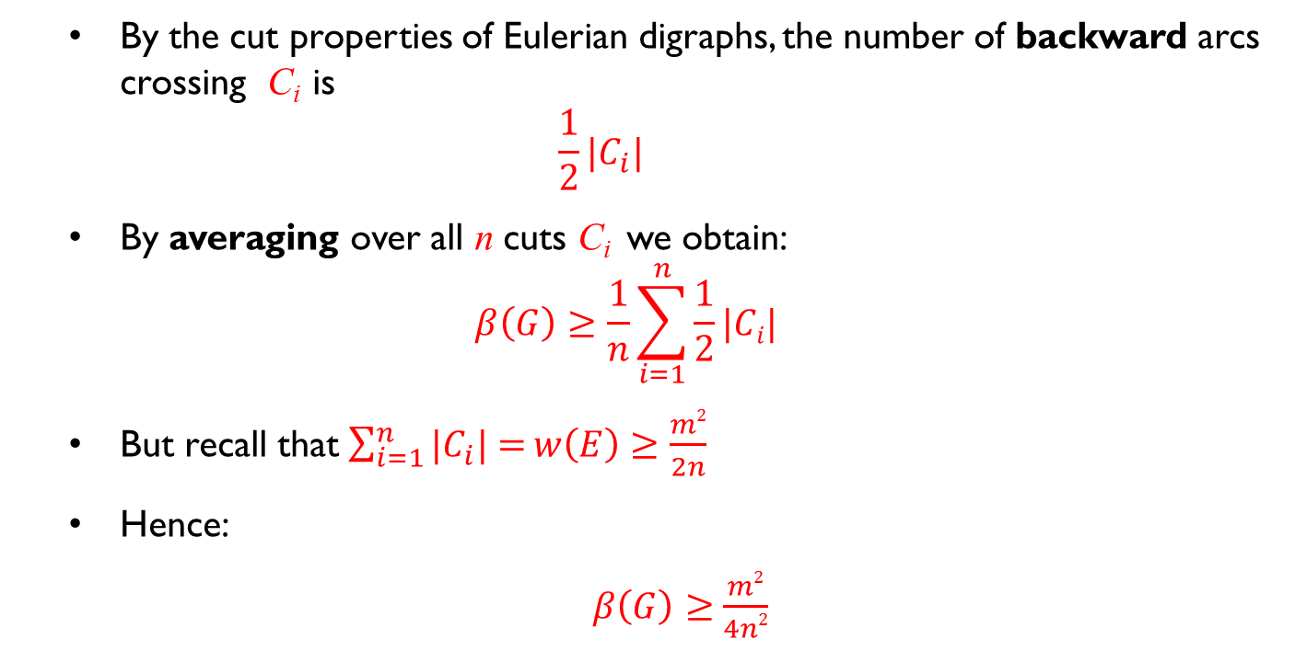
Proof sketch – short version (cont.)
By the cut properties of Eulerian digraphs, the number of backward arcs crossing C_{i} is
$\frac{1}{2}|C_{i}|$
By averaging over all n cuts C_{i} we obtain:
$$β\left(G\right)≥\frac{1}{n}\sum_{i=1}^{n}{\frac{1}{2}|Ci|}$$
  But recall that $\sum_{i=1}^{n}{|C_{i}|=}w\left(E\right)≥\frac{m2}{2n}$
Hence:
$β\left(G\right)≥$ $\frac{m2}{4n2}$

Slide 13
Proof sketch – long version
Consider a linear order v₁,…,v_{n} of V(G).
An arc (v_{i},v_{j}) is backward (resp. forward) if i > j (resp. i < j).
Suffices to prove that the number of backward arcs is at least the value stated in the theorem.
The length of an arc (v_{i},v_{j}) is defined as |i-j| .
An arc is short if its length is at most n/2. Otherwise, it is long.
E(G) = S ∪ L
Assume γm=|S|. Hence (1-γ)m=|L|.
Let s_{i} denote the number of short arcs connecting v_{i} with some v_{j}
where j > i.
Note: we claim nothing regarding the directions of these arcs.

Slide 14
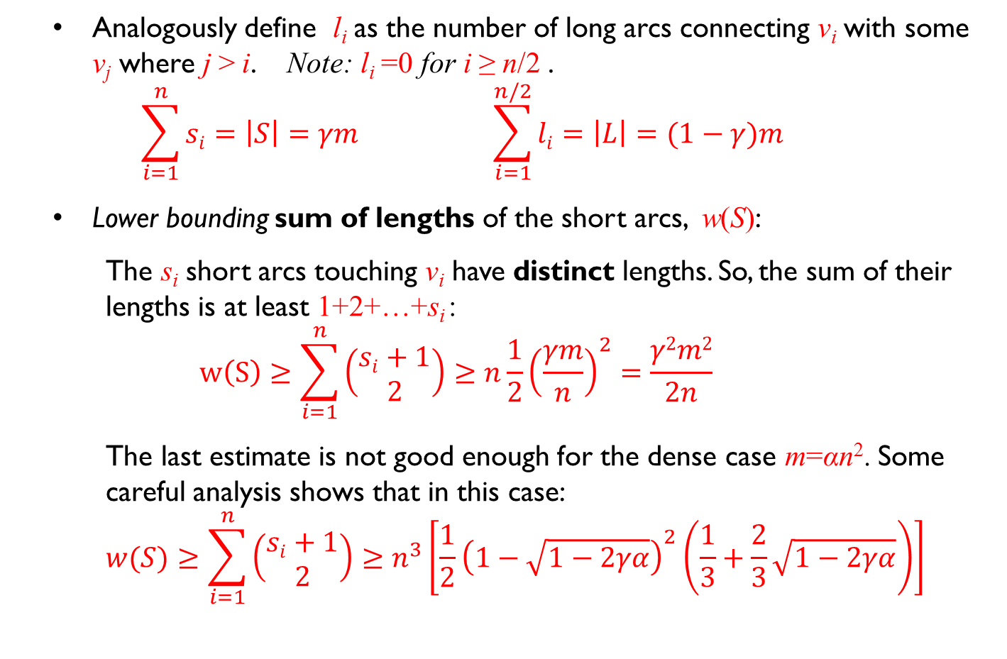
Proof sketch – long version (cont.)
Analogously define l_{i} as the number of long arcs connecting v_{i} with some v_{j} where j > i. Note: l_{i} =0 for i ≥ n/2 .
$\sum_{i=1}^{n}{si}=\left|S\right|=γm \sum_{i=1}^{n/2}{li}=\left|L\right|=(1−γ)m$
Lower bounding sum of lengths of the short arcs, w(S):
  The s_{i} short arcs touching v_{i} have distinct lengths. So, the sum of their lengths is at least 1+2+…+s_{i} :
  $$w\left(S\right)≥\sum_{i=1}^{n}{\left(\begin{matrix}si+1 \\ 2\end{matrix}\right)}≥n\frac{1}{2}{\left(\frac{γm}{n}\right)}^{2}=\frac{γ2m2}{2n}$$
  The last estimate is not good enough for the dense case m=αn². Some careful analysis shows that in this case:
  $$w(S)≥\sum_{i=1}^{n}{\left(\begin{matrix}si+1 \\ 2\end{matrix}\right)}≥n^{3}\left[\frac{1}{2}{\left(1−\sqrt{1−2γα}\right)}^{2}\left(\frac{1}{3}+\frac{2}{3}\sqrt{1−2γα}\right)\right]$$

Slide 15
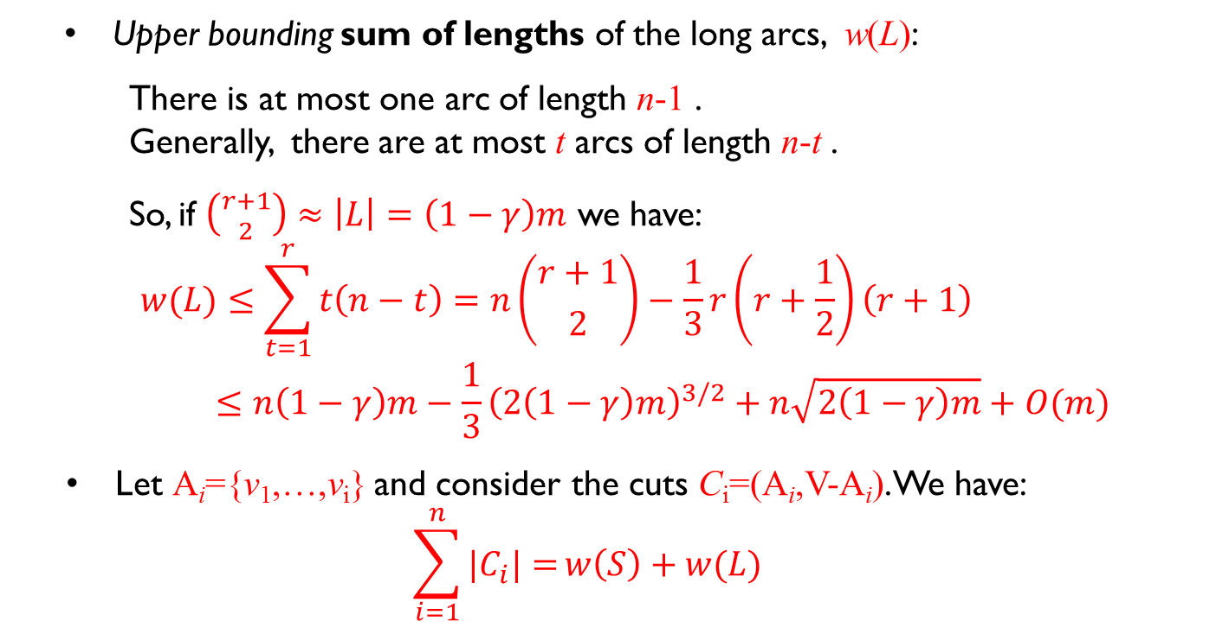
Proof sketch – long version (cont.)
Upper bounding sum of lengths of the long arcs, w(L):
  There is at most one arc of length n-1 .
  Generally, there are at most t arcs of length n-t .
  So, if $\left({r+1 \atop 2}\right)≈\left|L\right|=\left(1−γ\right)m$ we have:
  $$w(L)≤\sum_{t=1}^{r}{t\left(n−t\right)}=n\left({r+1 \atop 2}\right)−\frac{1}{3}r\left(r+\frac{1}{2}\right)\left(r+1\right) \\ ≤n\left(1−γ\right)m−\frac{1}{3}{\left(2\left(1−γ\right)m\right)}^{3/2}+n\sqrt{2\left(1−γ\right)m}+O(m)$$
  Let A_{i}={v₁,…,v_{i}} and consider the cuts C_{i}=(A_{i},V-A_{i}). We have:
  $$\sum_{i=1}^{n}{|C_{i}|=}w\left(S\right)+w(L)$$

Slide 16
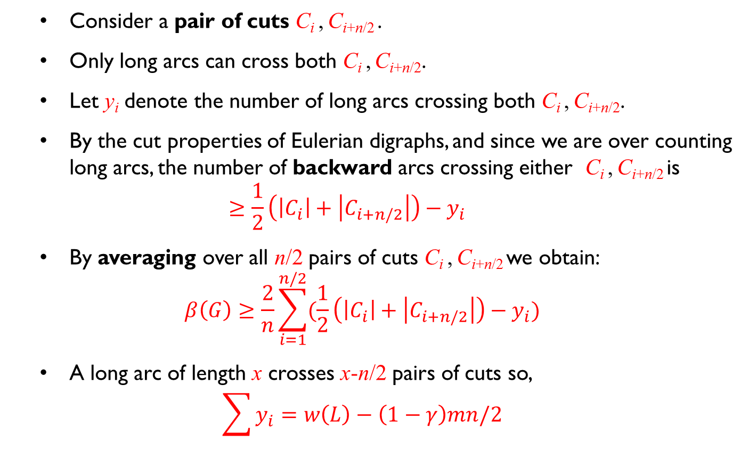
Proof sketch – long version (cont.)
Consider a pair of cuts C_{i} , C_{i+n/2} .
Only long arcs can cross both C_{i} , C_{i+n/2}.
Let y_{i} denote the number of long arcs crossing both C_{i} , C_{i+n/2}.
By the cut properties of Eulerian digraphs, and since we are over counting long arcs, the number of backward arcs crossing either C_{i} , C_{i+n/2} is
$≥\frac{1}{2}\left(\left|C_{i}\right|+\left|C_{i+n/2}\right|\right)−y_{i}$
By averaging over all n/2 pairs of cuts C_{i} , C_{i+n/2} we obtain:
$$β\left(G\right)≥\frac{2}{n}\sum_{i=1}^{n/2}{(\frac{1}{2}\left(\left|C_{i}\right|+\left|C_{i+n/2}\right|\right)−y_{i})}$$
A long arc of length x crosses x-n/2 pairs of cuts so,
$$\sum{y_{i}}=w\left(L\right)−\left(1−γ\right)mn/2$$

Slide 17
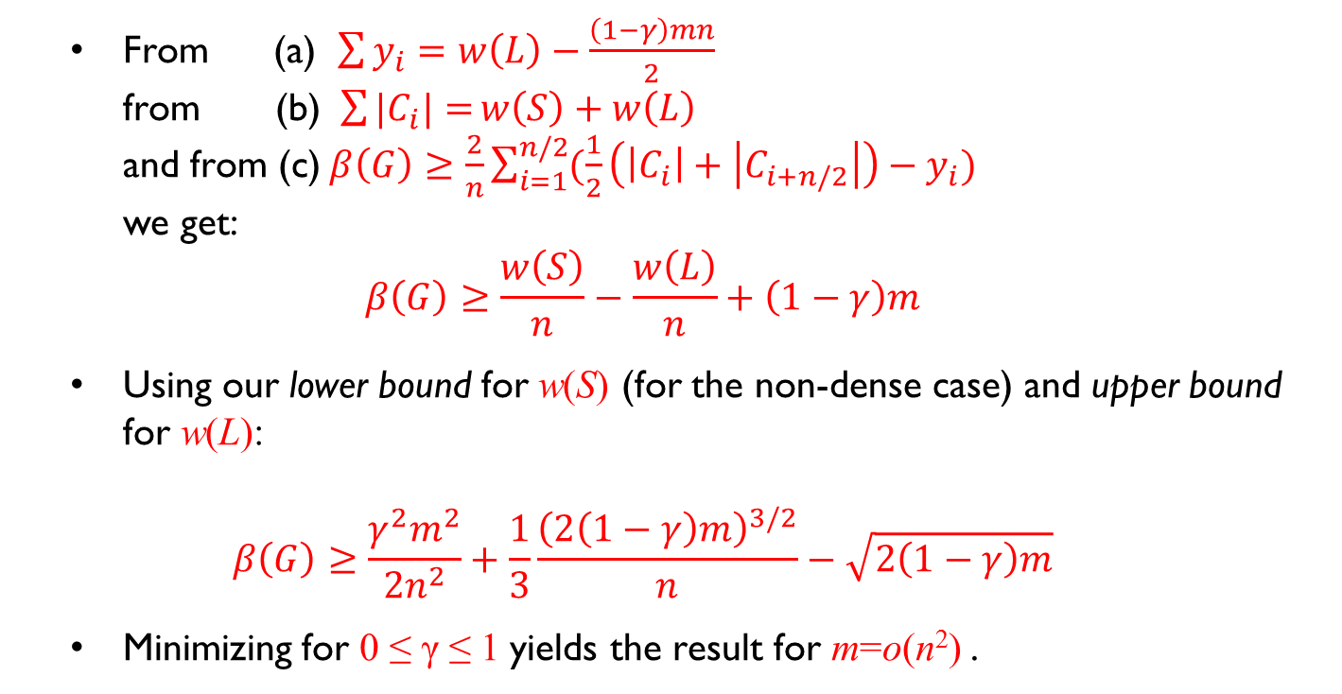
Proof sketch – long version (cont.)
From (a) $\sum{y_{i}}=w\left(L\right)−\frac{\left(1−γ\right)mn}{2}$
from (b) $\sum{|C_{i}|=}w\left(S\right)+w\left(L\right)$
and from (c) $β\left(G\right)≥\frac{2}{n}\sum_{i=1}^{n/2}{(\frac{1}{2}\left(\left|C_{i}\right|+\left|C_{i+n/2}\right|\right)−y_{i})}$
we get:
$$β\left(G\right)≥\frac{w\left(S\right)}{n}−\frac{w\left(L\right)}{n}+\left(1−γ\right)m$$
Using our lower bound for w(S) (for the non-dense case) and upper bound for w(L):
$$β\left(G\right)≥\frac{γ^{2}m^{2}}{2n^{2}}+\frac{1}{3}\frac{{\left(2\left(1−γ\right)m\right)}^{3/2}}{n}−\sqrt{2\left(1−γ\right)m}$$
Minimizing for 0 ≤ γ ≤ 1 yields the result for m=o(n²) .

Slide 18
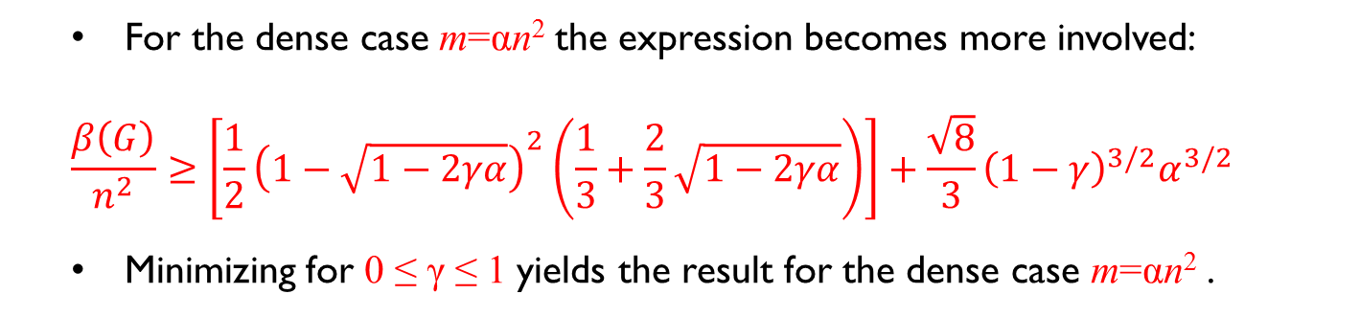
Proof sketch – long version (cont.)
  For the dense case m=αn² the expression becomes more involved:
$$\frac{β\left(G\right)}{n^{2}}≥\left[\frac{1}{2}{\left(1−\sqrt{1−2γα}\right)}^{2}\left(\frac{1}{3}+\frac{2}{3}\sqrt{1−2γα}\right)\right]+\frac{\sqrt{8}}{3}{\left(1−γ\right)}^{3/2}α^{3/2}$$
Minimizing for 0 ≤ γ ≤ 1 yields the result for the dense case m=αn² .

Slide 19
Random DFS
  Take a random permutation of the vertices.
  Performing DFS: When a vertex has to decide to which unmarked outgoing neighbor to go recursively, it picks the one with smallest permutation index.
  Conjecture: The expected depth is at least θ(m/n).
  Not true for arbitrary DFS.

Slide 20
Thanks

